Slide 1
Petrologia e Geodinamica
Laurea Magistrale in
Geologia di Esplorazione
Dipartimento di Scienze della Terra
Università degli Studi di Roma La Sapienza
Michele Lustrino
(michele.lustrino@uniroma1.it. Tel: 06 49914158. Stanza 114)

Slide 2
Part Three.
Geotherm;
Mantle Adiabat;
Mantle Potential Temperature.

Slide 3
Why a mantle melts
We will discuss in more detail the various variables presenting case studies of Cenozoic “orogenic” and “anorogenic” igneous rocks of the Circum-Mediterranean area.
We will see how many different hypotheses have been proposed in literature to explain magma genesis in complex systems like the Mediterranean.
Before proceeding, just a few words on basic concepts like Geotherm, Mantle Adiabat and Potential Temperature.

Slide 4
Geotherm
The Geotherm illustrates how the temperature of the Earth changes with depth.
Temperature increases with depth at rates from ~0.5 to >200 °C/km.
The variation of temperature with depth in the Earth’s crust and mantle cannot be directly measured and must be inferred.
One of the more direct indications of interior temperatures is provided by the eruption temperatures of volcanoes and the matching of those temperatures with knowledge of the depth of origin and magma/source relationship.
Green et al., 2001 (Eur. J. Mineral. 13, 437-451)

Slide 5
Geotherm
Earthquakes and volcanic activity are the physical expression of a cooling Earth.
A Boundary Layer is a transitional area between two distinct regions with different physical properties.
There are TWO main Thermal Boundary Layers in the Earth.
One is the Surface. Here the temperature rises from ~0 °C to ~1500 °C across a depth interval of ~100-200 km.
The other is the D” (Core-Mantle Boundary Layer). Here the temperature rises from ~2000 °C to >3000 °C across a depth interval of ~200 km.
Foulger, 2010 (Plates vs Plumes – A Geological Controversy. Wiley-Blackwell)

Slide 6
Geotherm
At the mantle’s base, the magnitude of the thermal and chemical boundary layers exceeds those at the surface.
The density, chemistry, viscosity and temperature contrast between mantle and core is larger than that between crust and atmosphere.
ρ_{air}: ~0.001 g/cm³
ρ_{upper crust}: ~2.8 g/cm³
Δρ: ~2.8 g/cm³
T_{air}: ~14 °C
T_{Moho}: ~500-800 °C
ΔT: ~500-800 °C
ρ_{lower mantle}: ~4.5 g/cm³
ρ_{liquid core}: ~10-12 g/cm³
Δρ: ~5.5-7 g/cm³
T_{lower mantle}: ~2000-2300? °C
T_{liquid} core: ~3000-4000? °C
ΔT: ~700-2000 °C

Slide 7
Geotherm
The upper thermal boundary layer facilitates subduction, via thermal contraction, and the return of heterogeneity to the deep mantle. The accumulation of magma at the surface depends on the presence of the large density contrast with the overlying ocean and atmosphere.
Heterogeneity produced near the surface is constantly being added via subduction back into the mantle.
Some of this subducted material continues its journey around the shallow rock cycle by returning to the surface in arc magmas, but the great majority of the subducted mass, in the form of the oceanic crust and its depleted residue, continues its descent to much greater depths.
Stixrude and Lithgow-Bertelloni, 2012 (Annu. Rev. Earth Planet. Sci., 40, 569-595)

Slide 8
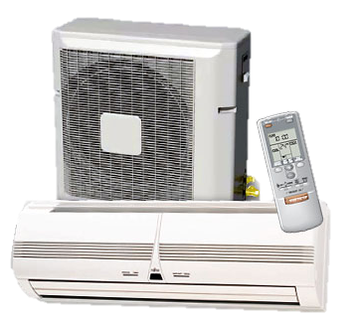
Mantle Adiabat
When ascending mountains the temperature decreases. This is consequence of air compressibility.
With decreasing pressure air expands and the temperature decreases. This means that there exists an adiabatic temperature gradient responsible for the decrease of temperature at high altitudes.
This is the working principle of air cooling systems.

Slide 9
Mantle Adiabat
The same happens if solid mantle or partial melts ascend from the Earth’s interior to the surface.
The adiabat is defined as the decrease of temperature with decrease of pressure.
The adiabat for solid mantle is ~0.4-0.6 °C/km (~1.8 °C/kbar).
The adiabat for melts is higher (~1 °C/km; ~3 °C/kbar) because these are more compressible/expandable.
The adiabat for the air is even higher (~10 °C/km).

Slide 10
Mantle Adiabat
Does the temperature in the Earth’s interior vary following the solid adiabat?
YES, NO, MAY BE
In some regions of the mantle the geotherm is super-adiabatic (i.e. the ΔT/ΔP is higher than the solid adiabat).
In other regions the geotherm is likely to coincide with the solid adiabat (i.e., it is adiabatic).
In other regions there is no agreement on how the geotherm varies (it has been assumed that the ΔT/ΔP is lower than the adiabat, i.e., sub-adiabatic).

Slide 11
Mantle Adiabat
The upwelling of mantle material (either solid or melt) is not isothermal.
The upwelling of solid mantle is considered to be always adiabatic (i.e., without exchange of heat and mass) but with decreasing of temperature.
What will be the drop in T of a solid mantle upwelling from 200 to 100 km without melting?
~40-60 °C
What will be the drop in T of a melt upwelling from 200 to 100 km?
~100 °C

Slide 12
Mantle Adiabat
A homogeneous static self-compressed originally isothermal solid will have an adiabatic gradient.
A cooling or internally heated convecting sphere cannot have an adiabatic gradient.
Is the Earth’s interior truly adiabatic or not?
D.L. Anderson, written cummunication, 2012
Notes:
12

Slide 13
Mantle Adiabat
Does it exist a difference between Geotherm and Mantle Adiabat?
How are these two concepts related?
These two concepts are not completely linked.
The upwelling of a solid mantle (or a melt) is always adiabatic.
The temperature variation with P (geotherm) can be adiabatic, subadiabatic or superadiabatic.

Slide 14
Geotherm
Temperature (°C)
2000
4000
6000
High ΔT/ΔP
?
Thermal Boundary Layer
1000
Mantle
Low ΔT/ΔP
Next slide
?
2000
?
High ΔT/ΔP
3000
Depth (km)
?
Thermal Boundary Layer
Outer Core (liquid)
4000
?
Low ΔT/ΔP
5000
Inner Core (solid)
?
6000
Geotherm
Notes:
14

Slide 15
Geotherm
Temperature (°C)
1000
2000
3000
4000
0
Upper Boundary Layer
Hypothetical Mantle Plume Tp
Super- or Sub-adiabatic?
Adiabatic interior?
Hypothetical Ambient Mantle Tp
1000
Mantle adiabat ~0.6 K/km
Depth (km)
~0.6 K/km
~0.6 K/km
This is the classical view of the heat distribution in the Earth’s interior (standard Cambridge School Model; McKenzie and Bickle, 1988)
2000
Classically accepted Geotherm (e.g., Hassan et al., 2015)
Lower Boundary Layer
3000
Super- or Sub-adiabatic?
Notes:
15

Slide 16
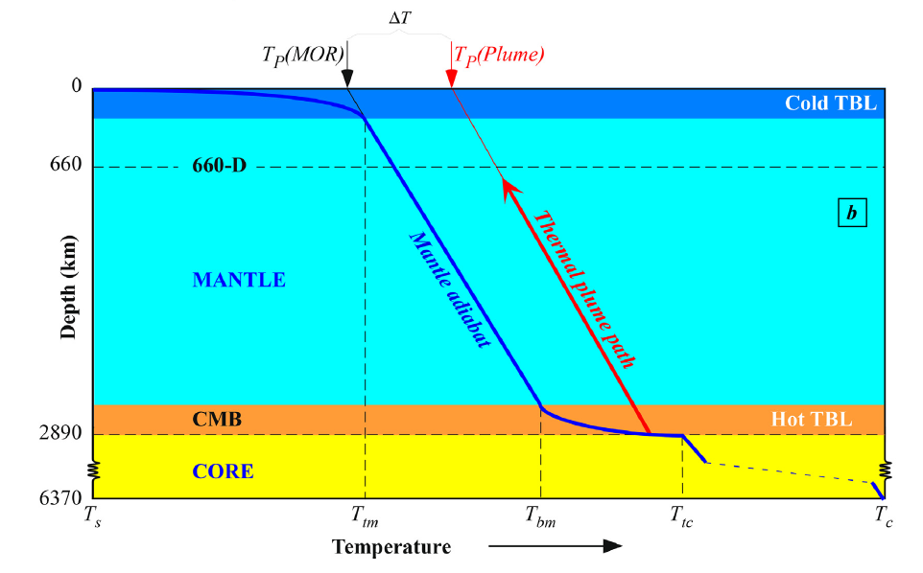
Geotherm
Temperature (°C)
ΔT
1000
2000
3000
4000
0
Upper Boundary Layer
Hypothetical Mantle Plume Tp
Super- or Sub-adiabatic?
Adiabatic interior?
Hypothetical Ambient Mantle Tp
1000
Mantle adiabat ~0.6 K/km
Depth (km)
~0.6 K/km
~0.6 K/km
This is the classical view of the heat distribution in the Earth’s interior (standard Cambridge School Model; McKenzie and Bickle, 1988)
2000
Classical representation of Earth's interior temperature distribution
Classically accepted Geotherm (e.g., Hassan et al., 2015)
Adiabatic geotherm (constant Tp for much of the mantle);
Two super-adiabatic regions (upper and lower TBLs);
Upper core much hotter than lower mantle;
Mantle plumes derived from CMB.
Lower Boundary Layer
3000
Super- or Sub-adiabatic?
Niu, 2020 (J. Asian Earth Sci., 194, 104367)
Notes:
16

Slide 17
Geotherm
Temperature (°C)
According to the most recent experimental results, a T of >3750 °C is necessary for MORB partial melting at CMB pressures.
Thus it seems unlikely to have MORB melting at CMB (Pradhan et al., 2015, EPSL, 431, 247-255).
1000
2000
3000
4000
0
1000
MORB solidus
Depth (km)
The MORB melt would be, in any case, very enriched in Fe (i.e., stable at CMB or negatively buoyant).
2000
Classically accepted Geotherm (e.g., Hassan et al., 2015)
3000
Notes:
17

Slide 18
Temperature (°C)
1000
2000
3000
4000
0
Hoink and Lenardic (2008; thin asthenosphere)
Tackley et al. (1993)
Schuberth et al. (2009)
Hoink and Lenardic (2008; thick asthenosphere)
1000
Moore (2008; no internal heating)
King (2015)
Moore (2008; internal heating)
Nakagawa et al. (2015)
Depth (km)
Sinha and Butler (2007; no internal heating)
Zhong and Rudolph (2015)
2000
Sinha and Butler (2007; internal heating)
Coltice et al (2018)
Ulvrova et al (2019)
(min-med-max)
3000
Notes:
18

Slide 19
Tp deep mantle
Tp shallow mantle
Temperature (°C)
According to more realistic geotherms, the Tp of the shallow mantle is higher than that of the deepest mantle!
1000
2000
3000
4000
0
Hoink and Lenardic (2008; thin asthenosphere)
Tackley et al. (1993)
Schuberth et al. (2009)
Hoink and Lenardic (2008; thick asthenosphere)
1000
Moore (2008; no internal heating)
King (2015)
Moore (2008; internal heating)
Nakagawa et al. (2015)
Depth (km)
Sinha and Butler (2007; no internal heating)
Zhong and Rudolph (2015)
2000
Sinha and Butler (2007; internal heating)
Coltice et al (2018)
Ulvrova et al (2019)
(min-med-max)
3000
Notes:
19

Slide 20
Geotherm
Temperature (°C)
1000
2000
3000
4000
Hotter than “expected”?
0
Internal heating (U, Th, K radiogenic heat); Shear heating
Slab cooling in the TZ
1000
Depth (km)
2000
Colder than “expected”?
Slab cooling or secular cooling of the core
3000
…Or low CMB temperature…
Notes:
20

Slide 21
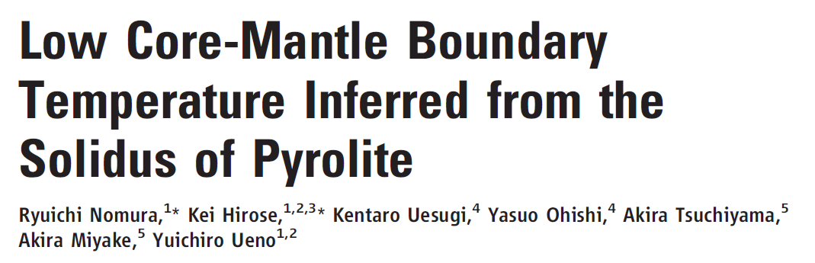
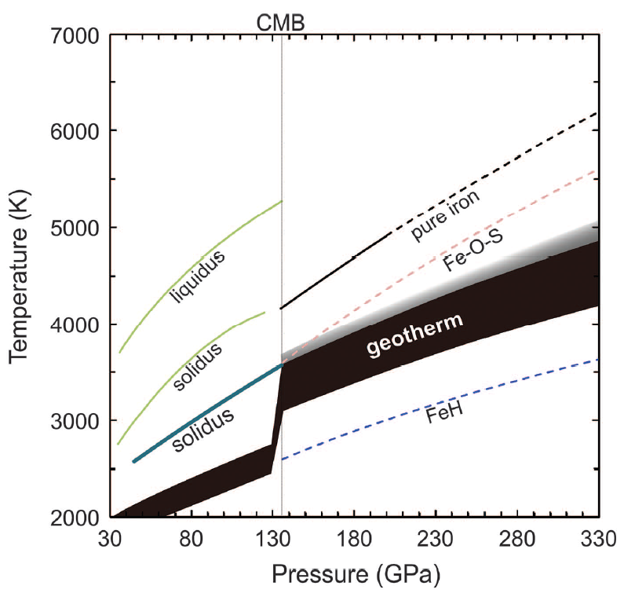
Geotherm
Old studies (Fiquet et al., 2010, Science)
ΔT >400 K
ΔT
New solidus
Notes:
21

Slide 22
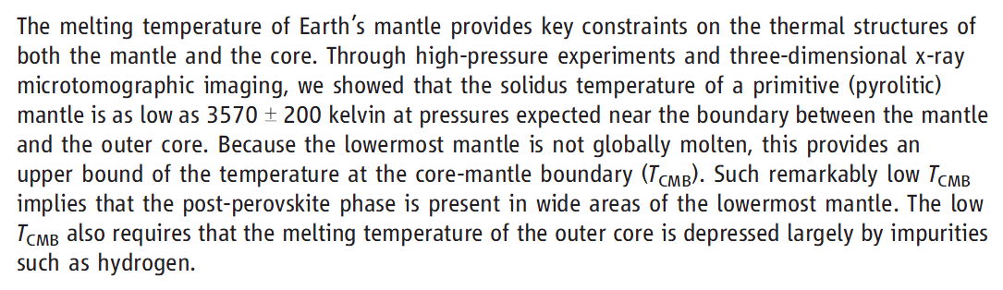
Geotherm
Old studies (Fiquet et al., 2010, Science)
ΔT >400 K
ΔT
New solidus
Notes:
22

Slide 23
Geotherm
Old studies (Fiquet et al., 2010, Science)
ΔT >400 K
ΔT
New solidus
Light elements (Si, O, S) can reduce the melting point of Fe at CMB up to 700 K.
T_{CMB} can be as low as 3270 K (~3000 °C)
Terasaki et al., 2011 (Earth Planet. Sci. Lett., 304, 559-564
Notes:
23

Slide 24
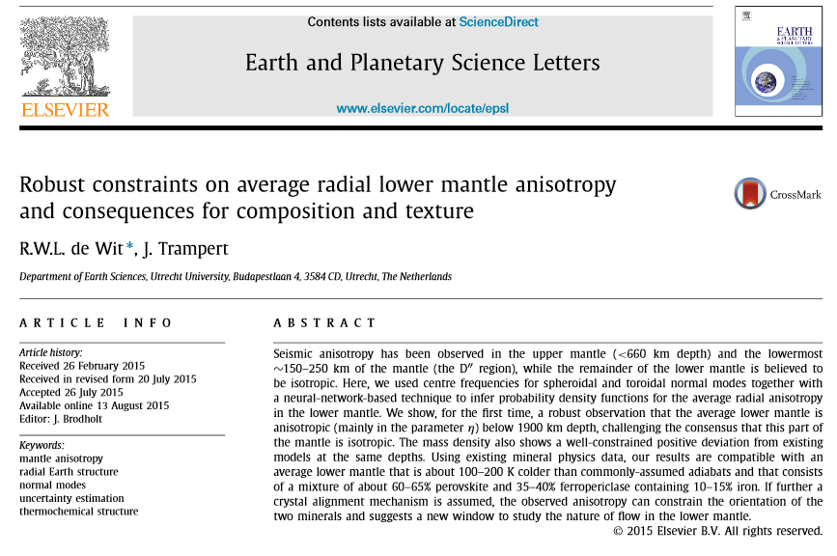
Geotherm
Notes:
24

Slide 25
Geotherm
Temperature (°C)
“Classical view”
1000
2000
3000
4000
0
MORB source is shallow (because cold)
T_{CBM} ~4000 °C
(to compare with T_{CMB} estimates of ~3000 °C)
1000
Depth (km)
Considerations based on the stability of post-perovskite require T_{CMB} ~3500 °C
2000
OIB source is very deep (because hot)
3000
Notes:
25

Slide 26
Geotherm
Temperature (°C)
“Alternative view”
1000
2000
3000
4000
0
MORB source is deep
(but still in the shallow mantle) (because cold)
1000
No involvement of deep mantle material.
Depth (km)
2000
OIB source is shallow
(because hot)
3000
Notes:
26

Slide 27

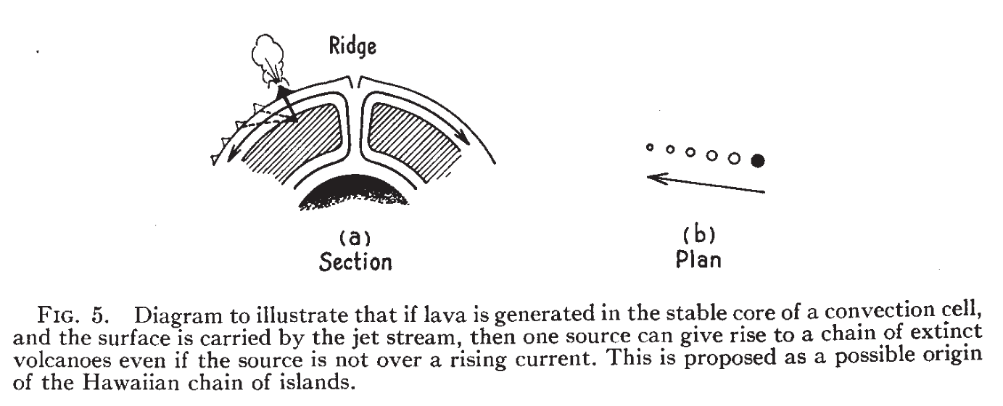
Geotherm
shallow
Wilson (1963) Can. J. Phys., 41, 863-870
OIB = Shallow source (~200 km depth)
MORB = Deep source
Notes:
27

Slide 28
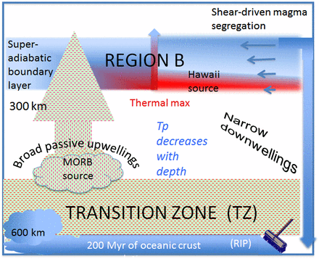
Geotherm
“New” paradigm:
- MORB source deep;
- OIB source shallow
Anderson and Natland (2014) Proc. Natl. Acad. Sci. 111, E4298-E4304
Notes:
28

Slide 29
Geotherm
Classically accepted heat distribution with depth
Alternative heat distribution with depth (with sub-adiabatic geotherm)
Depth
Notes:
29

Slide 30
Potential Temperature
In order to determine the heat content of two air masses it is necessary to measure the temperatures at the same pressure.
We need to know the heat content of two solid or melt masses. Also in this case we should compare these two masses at the same pressure.
For this reason a new temperature has been defined, i.e. the Potential Temperature (Tp).
In this case the temperature of the mantle is referred to pressure = 1 atm
(i.e. pressure at sea level).

Slide 31
Potential Temperature
In other words, the Potential Temperature (Tp) is the temperature that a point in the mantle would have if it were taken adiabatically to a reference pressure (Earth’s surface).
Tp is a convenient measure of the temperature of the mantle and its variations but it does not imply, as commonly assumed, that the mantle is convecting or that it supports an adiabatic temperature gradient.
Each point in the superadiabatic conduction layer has associated with it a Tp, as does every point in an internally heated subadiabatic mantle.
D.L. Anderson, written comunication, 2011
Notes:
31

Slide 32
Potential Temperature
How is the potential temperature calculated?
The potential temperature is the temperature the mass would have (hence the term “potential”) if it were compressed or expanded to some constant reference pressure (1 atm).
The potential temperature is calculated prolonging the mantle adiabat to P = 1 atm.

Slide 33
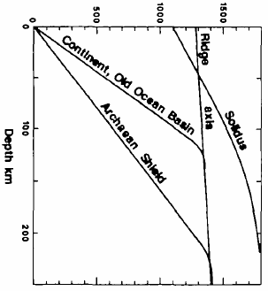
Potential Temperature
What temperature is calculated?
Is there one single MANTLE Potential Temperature?
If the temperature in the mantle were purely adiabatic and laterally invariant, the Tp would be the same everywhere (…and the mantle would not convect).
Non Adiabatic Gradient
However, these are not valid assumptions, because of the presence of subduction, radioactive heating and convecting movements.
Adiabatic Gradient
This figure assumes that the sub-lithospheric mantle is isentropic.
Notes:
33

Slide 34
Potential Temperature
What temperature is calculated?
Is there one single MANTLE Potential Temperature?
In the conductive layer (the outermost shell of the Earth), the temperature gradient is Non-Adiabatic (i.e., it increases very rapidly, from ~0 °C to ~1500 °C in the ~100-200 km depth interval).
Non Adiabatic Gradient
Adiabatic Gradient
What is the Temperature at the base of the Conductive Layer?
Notes:
34

Slide 35
Potential Temperature
What temperature is calculated?
Is there one single MANTLE Potential Temperature?
The Tp at the base of the conductive layer, and beneath it, is variable and its average value is not accurately known.
Non Adiabatic Gradient
Adiabatic Gradient
What is the Temperature at the base of the Conductive Layer?
Notes:
35

Slide 36
Potential Temperature
What temperature is calculated?
Is there one single MANTLE Potential Temperature?
According to many researchers (following the Cambridge model) the temperature inferred from MORB formation represents the AVERAGE Tp.
Non Adiabatic Gradient
Adiabatic Gradient
What is the Temperature at the base of the Conductive Layer?
Notes:
36

Slide 37
Potential Temperature
What temperature is calculated?
Is there one single MANTLE Potential Temperature?
The Cambridge Model assumes that the Potential Temperature can be defined for the convecting (adiabatic) volume of the mantle only.
Non Adiabatic Gradient
Tp can be defined everywhere
Adiabatic Gradient
The mantle does not have to be adiabatic or convecting.
Notes:
37

Slide 38
Potential Temperature
What temperature is calculated?
Alternative (not correct) definitions are:
“The mantle potential temperature Tp is simply the metastable extension to the surface of the adiabat from the solid convecting part of mantle at depth.”
(Herzberg and Asimow (2008) Geochem. Geophys. Geosyst., 8, doi:10.1029GC002057)
“The temperature that the solid adiabatically convecting mantle would be at the surface if it did not melt is called the potential temperature.”
(Herzberg, 2011, Geology, 39, 1179-1180)
Notes:
38

Slide 39
Potential Temperature
The concept itself of Tp should be considered in relation to the depth of magma formation.
To every point in the mantle can be assigned a Tp bringing that point up, adiabatically, to the surface.
Magmas formed at high P in the superadiabatic part of the mantle show high Tp; magmas formed at shallower P show lower Tp.
This does not imply any kind of thermal anomaly, but it indicates a temperature gradient in the mantle.

Slide 40
Potential Temperature
What temperature is calculated?
Is there one single MANTLE Potential Temperature?
When dealing with Mantle Potential Temperature we are referred to the temperature of the mantle when it partially melts.
Non Adiabatic Gradient
We calculate Tp indirectly, studying partial melts of a
Adiabatic Gradient
mantle source.
Notes:
40

Slide 41
Potential Temperature
Let us assume to different types of lithospheres.
MBL
Lithosphere
Lithosphere (McK&B88)
Type 1:
“Normal” continental lithosphere (thickness of mechanical boundary layer ~60 km; thermal boundary layer ~130 km).
TBL
Geotherm
Asthenosphere

Slide 42
Potential Temperature
The geotherm of type 1 lithosphere shows a clear kink at the base of the thermal boundary layer.
MBL
TBL
This is related to the transition from the convective to the conductive regions.

Slide 43
Potential Temperature
In this case the potential temperature (following the Cambridge School) is obtained by continuing the mantle adiabat in the convective region up to surface pressure.
1280 °C
The potential temperature of this example is 1280 °C.

Slide 44
Potential Temperature
Let us assume a second type of lithosphere.
MBL
Geotherm
Type 2:
“Cratonic” continental lithosphere (thickness of mechanical boundary layer ~150 km; thermal boundary layer ~230 km).
Lithosphere
TBL
Asthenosphere

Slide 45
Potential Temperature
Also in this case continue the mantle adiabat in the convecting region up to surface pressure.
1280 °C
Also in this case the potential temperature is assumed to be 1280 °C.

Slide 46
Potential Temperature
The crust and lithosphere are usually interpreted as a thin boundary layer over the asthenosphere, which is inferred to have a potential temperature of 1280 °C and adiabatic temperature distribution with depth.
The asthenosphere composition is inferred to be a reasonably well mixed and slightly residual lherzolite evolved from the silicate component of the primitive Earth by separation of the continental and oceanic crust and lithosphere over ~4.5 billion years.

Slide 47
Potential Temperature
Although MOR basalts are interpreted as sampling a modern, well-mixed mantle source (asthenospheric mantle), a second, relatively distinctive volcanism, ‘island chain’ or ‘hot spot’ volcanism is widely interpreted as sampling a different source or sources.
The ‘hot spot’ sources are relatively fixed with respect to plate-movements and are fixed or show very slow movement relative to one another.
The ‘fixed’ source could be as shallow as 200 km (e.g., Wilson, 1963).

Slide 48
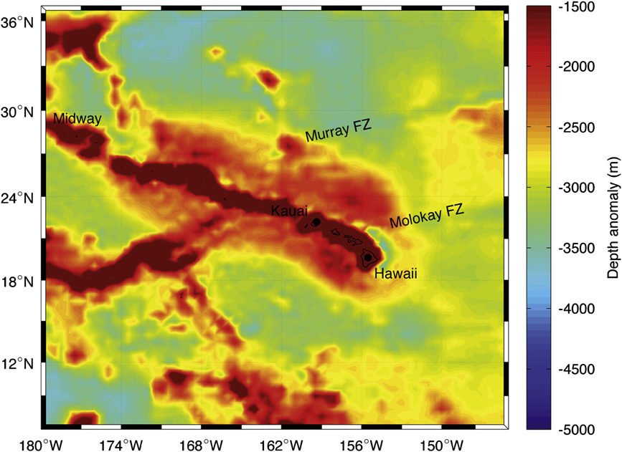
Potential Temperature
The presence of a BUOYANT PLUME or Lower Density Column has been considered the origin of the
broad bathymetric high of the Hawaiian Arch (or H. Swell).
The buoyancy plume is normally attributed to a temperature difference with ΔT ~200–250 °C (rarely to 500 °C or down to 100 °C) between the normal mantle and upwelling plume (McK& B, 1988).
Cadio et al., 2012 (Earth Planet. Sci. Lett., 359-360, 40-54)

Slide 49
Potential Temperature
In much of the literature on mantle plumes, particularly on plumes from a postulated thermal boundary layer at the
core-mantle boundary, there is explicit reference to temperature difference between upwelling plume and ambient mantle of at least 200 °C.
Green et al., 2001 (Eur. J. Mineral., 13, 437-451)
Cadio et al., 2012 (Earth Planet. Sci. Lett., 359-360, 40-54)

Slide 50
Potential Temperature
Alternatively, the swell could actually be held up a thick harzburgitic section under the swell.
Why should the presence of harzburgite cause the swell?
Is harzburgite depleted or enriched in terms of major element content?
Is it Fe-rich or Fe-poor?
Cadio et al., 2012 (Earth Planet. Sci. Lett., 359-360, 40-54)

Slide 51
Potential Temperature
The concept of potential temperature is used to have an idea of the thermal state of the mantle.
1280 °C
It is not possible to say “the temperature of the mantle of a given area is 1200 or 1500 °C”.
We can only say that the temperature of a mantle in a given region is 1200 or 1500 °C if we refer to a reference pressure.
In these cases the reference pressure is 1 atm.

Slide 52
Potential Temperature
The Cambridge model assumes 1280 °C as the “average” potential temperature of a “normal” mantle.
1280 °C
In other words, the isotherm of ~1300 °C is considered the temperature at the base of the lithosphere, whatever is its thickness.
In these cases the reference pressure is 1 atm.

Slide 53
Potential Temperature
The Cambridge model assumes 1280 °C as the “average” potential temperature of a “normal” mantle.
1280 °C
1480 °C
In the presence of alleged “mantle plumes” a much hotter potential temperature has been hypothesized (up to 1500-1600 °C).
In these cases the reference pressure is 1 atm.

Slide 54
Potential Temperature
The Cambridge model assumes 1280 °C as the “average” potential temperature of a “normal” mantle.
1280 °C
1480 °C
Note, however, that higher Tp can be simply related to a thicker lithosphere (i.e., deeper origin).
In these cases the reference pressure is 1 atm.

Slide 55
Potential Temperature
To summarize, the Cambridge model assumes that:
1280 °C
1) The maximum lithospheric thickness in oceanic basins is ~100 km
1480 °C
2) The temperature at the base of the lithosphere is 1280 °C; This approach assumes that at 100 km depth the mantle is isothermal (and also chemically and mineralogically homogeneous).
In these cases the reference pressure is 1 atm.
3) The sub-lithosphere temperature gradient is adiabatic.

Slide 56
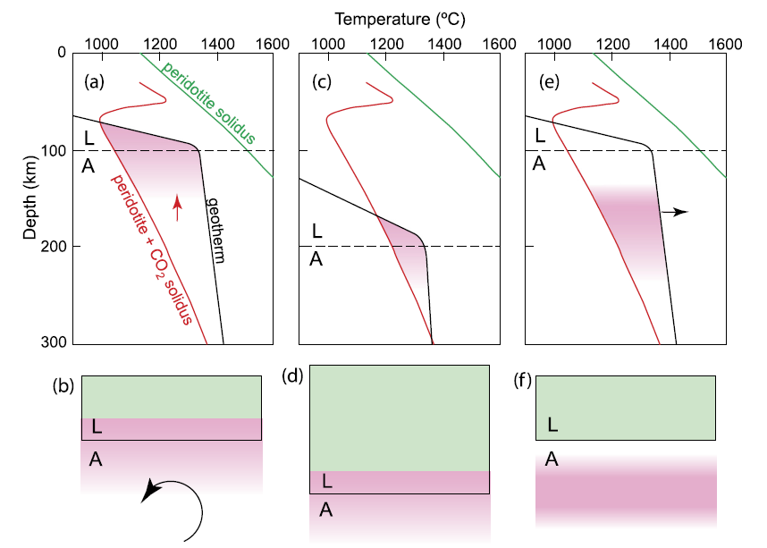
Potential Temperature
This remains the classical approach also in modern petrology studies
The sub-lithospheric mantle Tp is assumed to be ~1300 °C
Guimaraes et al. 2020 (EPSL, 536, 116147)

Slide 57
Potential Temperature
Adiabatic decompression paths
Temperature (°C)
1280°
1100
1300
1500
1700
1900
0
What does happen here?
Solidus
Liquidus
2
90%
30%
50%
70%
20%
How the temperature of this piece of mantle will change during decompression?
10%
100
4
?
Pressure (GPa)
Depth (km)
Solid Mantle
6
200
1280°
8

Slide 58
Potential Temperature
Adiabatic decompression paths
Temperature (°C)
1280°
1380°
1480°
1580°
1100
1300
1500
1700
1900
0
In this example, a mantle with a Tp 1280 °C melts up to ~22%
Solidus
Liquidus
2
90%
30%
50%
70%
20%
10%
100
A mantle with a Tp 1380 °C melts up to ~30%
4
Pressure (GPa)
Depth (km)
Solid Mantle
A mantle with a Tp 1480 °C melts up to ~40%
6
200
1280°
1380°
1480°
1580°
8

Slide 59
Potential Temperature
Temperature (°C)
The degree of melting would be valid if a solid piece of mantle would upwell until the surface without getting cold (which is impossible).
1280°
1380°
1480°
1580°
1100
1300
1500
1700
1900
0
Solidus
Liquidus
2
90%
30%
50%
70%
20%
10%
100
4
Pressure (GPa)
Depth (km)
Solid Mantle
6
200
1280°
1380°
1480°
1580°
8

Slide 60
Potential Temperature
What is to remind from this diagram is:
Temperature (°C)
1280°
1380°
1480°
1580°
1100
1300
1500
1700
1900
0
Solidus
The higher the Tp, the deeper the beginning of melting.
Liquidus
2
90%
30%
50%
70%
20%
10%
100
4
Pressure (GPa)
This model is true in case of a homogeneous mantle source only.
Depth (km)
Solid Mantle
6
200
1280°
1380°
1480°
1580°
8

Slide 61
What do you expect will change in case of different mantle sources?
Potential Temperature
Does the adiabatic gradient change?
Temperature (°C)
1280°
1380°
1480°
1580°
1100
1300
1500
1700
1900
NO
0
Does the solidus shape change?
Solidus
YES
Liquidus
Does the liquidus shape change?
2
90%
30%
50%
70%
YES
20%
10%
100
Does the geotherm change?
4
Pressure (GPa)
NO
Does the melt composition change?
Depth (km)
Solid Mantle
YES
6
Does the depth of melting change?
200
1280°
1380°
1480°
1580°
YES
8

Slide 62
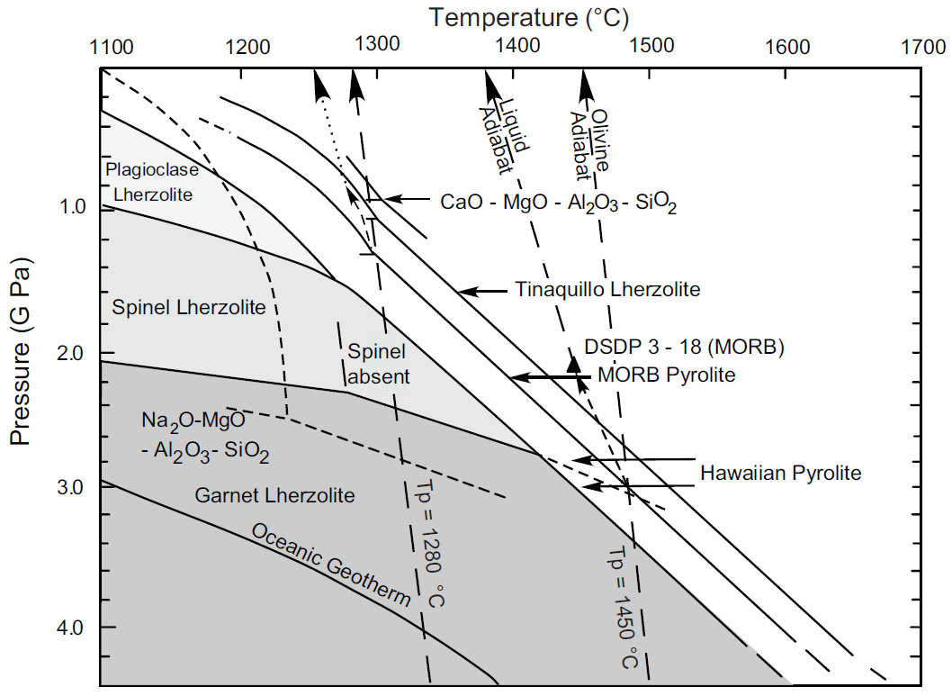
Potential Temperature
1280°C
1450°C
Solid Mantle (olivine) Adiabat (~0.6 °C/km or 18 °C/GPa)
Liquid Adiabat (~1 °C/km or 30 °C/GPa)
Note that the Liquid Adiabat may be even greater if melts react with wall-rock and cool.
Green and Falloon, 2005 (Geol Soc. Am. Spec. Paper, 388, 217-247)
Notes:
62

Slide 63
Did you understand what is the relation between the Geotherm, the Solidus and the Adiabat?
Potential Temperature
What are these lines?
Let’s simplify this diagram
And, above all, what is the meaning of these two lines?
This is another solidus reported in literature
(Herzberg and Asimow 2015)
What is this line?
What does this line represent?
Notes:
63

Slide 64
What is the Tp of the red star?
What is the Tp of the blue star?
~1170
~1310
Is the mantle represented by the blue star hotter than the red star?
Why is it hotter?
It is hotter because it is deeper, not because there is a heat excess or heat anomaly
Notes:
64

Slide 65
Are we calculating the Tp on the conductive or convective part of the geotherm?
~1170
~1310
At what depth a red star upwelling mantle would begin melting?
…And what is the depth of melting of a blue star mantle?
In a steady state condition, assuming this geotherm, does a mantle with the yellow star exist?
NO
Notes:
65

Slide 66
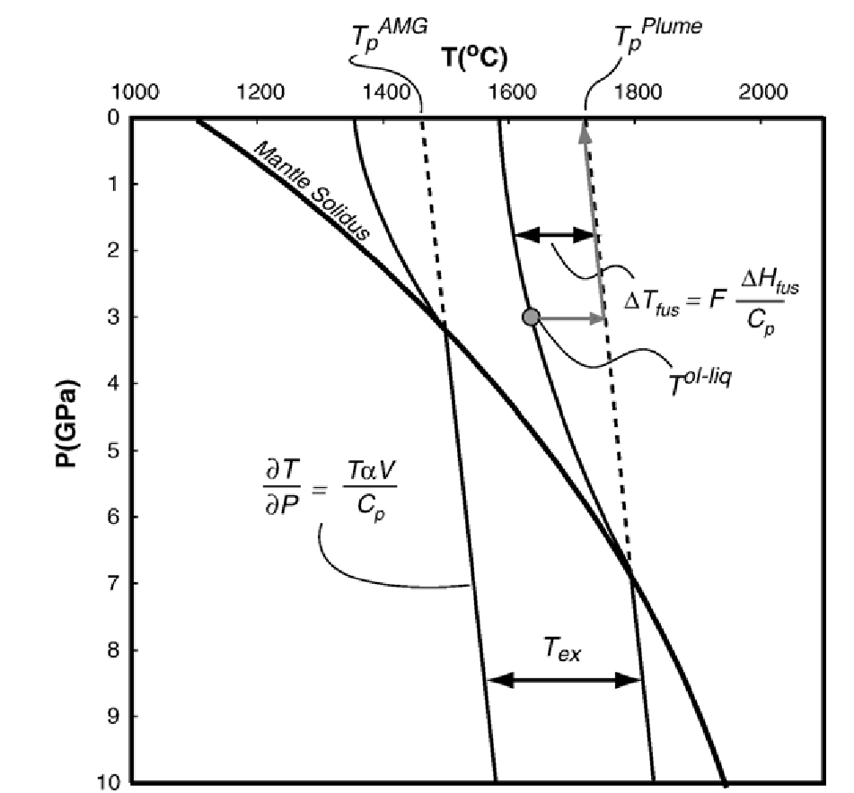
Potential Temperature
Let us give a look on the average Cratonic Geotherm
Why is there a kink in the geotherm?
In the lower part of the geotherm, the heat is transferred by convection (i.e., we are in the convecting part of the mantle).
Previous (Oceanic) Geotherm
Do here the geotherm and the adiabat coincide?
Average Cratonic Geotherm
Here the geothermal and the adiabatic gradients do not coincide
YES
In the shallow part of the geotherm, the decrease of T with P is much higher (i.e., superadiabatic condition).
Here the geothermal and the adiabatic gradients coincide
Do here the geotherm and the adiabat coincide?
NO
Putirka et al., 2007 (Chem. Geol., 241, 177-206)
Notes:
66

Slide 67
Potential Temperature
Tp = Mantle Potential Temperature.
~1440 °C
~1720°C
AMG = Average Mantle Geotherm (i.e., MORB-like source, not affected by thermal perturbations such as subduction or “mantle plumes”).
~1280
Tp^{AMG} = Mantle Potential Temperature of the convecting portion of the MORB-like mantle.
ΔT
~160 °C
Average Cratonic Geotherm
Tp^{Plume} = Mantle Potential Temperature of the deepest mantle (D”) carrying the heat excess of the outer core.
ΔT
~440 °C
McKenzie and Bickle (1988)
ΔT
T_{ex} = Excess Temperature of “plume” magmas.
~280 °C
Putirka et al., 2007 (Chem. Geol., 241, 177-206)
Notes:
67

Slide 68
Potential Temperature
[…] in the absence of mantle heterogeneity, parcels of mantle that have the same Tp will intersect the mantle solidus at the same depths, while mantle plumes, with higher Tp, must intersect the solidus at greater depths.
Average Cratonic Geotherm
…but can we imagine a mantle without heterogeneity?
Can we assume that the “MORB” source and the OIB plume source are the same?
Putirka et al., 2007 (Chem. Geol., 241, 177-206)
Notes:
68

Slide 69
Potential Temperature
What should you think looking at the parcel of the mantle @ the red star?
Does the higher Tp recorded by the yellow stars reflect higher absolute temperature (i.e., a true temperature excess) of such kind of mantle?
Average Cratonic Geotherm
No, obviously
Putirka et al., 2007 (Chem. Geol., 241, 177-206)
Notes:
69

Slide 70
Potential Temperature
What are the parameters influencing the mantle solidus?
Of course it depends on the composition of the source and, above all, its H and C content.
C-H-free mantle
…for example this is another possible solidus of a peridotitic mantle + excess water.
Average Cratonic Geotherm
This means that the depth of melting depends on the absolute T (Tp) but also on the composition of the source.
H₂O-saturated mantle solidus
Putirka et al., 2007 (Chem. Geol., 241, 177-206)
Notes:
70

Slide 71
Potential Temperature
Let us assume an Average Cratonic Geotherm.
If the solidus of the mantle is the red one (volatile-free conditions) can we have partial melt production without upwelling?
C-H-free mantle
NO
If the solidus of the mantle is the green one (H₂O-saturated conditions) can we have partial melt production without upwelling?
Average Cratonic Geotherm
Melt present
H₂O-saturated mantle solidus
YES
Where melting starts?
Putirka et al., 2007 (Chem. Geol., 241, 177-206)
Notes:
71

Slide 72
Potential Temperature
[…] Mantle potential temperatures and initial melting depths are thus intimately linked.
Is this really true?
The slope of the convective geotherm is assumed to be Adiabatic:
∂T/∂P=TαV/Cp (13-18 °C/GPa)
[13-18 °C/GPa = 0.4-0.6 °C/km]
T = temperature
P = pressure
α = coefficient of thermal expansion
V = molar volume
Cp = heat capacity
Cp = Q/ΔT
Specific heat
Cp = m*c
Mass
Putirka et al., 2007 (Chem. Geol., 241, 177-206)
Notes:
72
Heat capacity: Capacità termica (quantità di calore in joule che un sistema può immagazzinare aumentando la sua temperatura di un kelvin)

Slide 73
Potential Temperature
Once a parcel of mantle intersects
the solidus, energy is used to convert solid to liquid.
…This results in a temperature drop that is approximated by:
ΔTfus = F[ΔHfus/(Cp)]
Where:
ΔTfus = drop in temperature due to partial melting;
F = fraction of melt produced;
ΔHfus = heat of fusion;
Cp = heat capacity
ΔHfus is also known as latent heat of fusion or, more correctly, latent enthalpy of fusion (that is the amount of heat necessary to melt 1 mole of a substance).
Putirka et al., 2007 (Chem. Geol., 241, 177-206)
Notes:
73
Heat capacity: Capacità termica (quantità di calore in joule che un sistema può immagazzinare aumentando la sua temperatura di un kelvin)

Slide 74
Potential Temperature
Once a parcel of mantle intersects
the solidus, energy is used to convert solid to liquid.
…This results in a temperature drop that is approximated by:
ΔTfus = F[ΔHfus/(Cp)]
Why ΔTfus does increase approaching to the surface?
Because F increases with decreasing P.
Putirka et al., 2007 (Chem. Geol., 241, 177-206)
Notes:
74

Slide 75
Potential Temperature
In other words, measuring the olivine-liquid T it is possible to calculate the Potential Temperature of the mantle source.
Once a parcel of mantle intersects
the solidus, energy is used to convert solid to liquid.
…This results in a temperature drop that is approximated by:
ΔTfus = F[ΔHfus/(Cp)]
Assuming:
ΔHfus = 128 kJ/mole
Cp = 192 J/mole*K
α = 3*10⁻⁵/K
V = 4.6 J/bar
It is possible to convert olivine-liquid equilibration temperatures to Tp through a two-step process:
Tp = T^{ol-liq}+ΔTfus-P[∂T/∂P]
Putirka et al., 2007 (Chem. Geol., 241, 177-206)
Notes:
75

Slide 76
Potential Temperature
In other words, measuring the olivine-liquid T it is possible to calculate the Potential Temperature of the mantle source.
Once a parcel of mantle intersects
the solidus, energy is used to convert solid to liquid.
What are the variables that we can measure and what are those that can only be assumed to calculate Tp?
…This results in a temperature drop that is approximated by:
ΔTfus = F[ΔHfus/(Cp)]
T^{ol-liq} = can be calculated (we will see after how to do this)
ΔTfus = can be calculated.
Assuming:
ΔHfus = 128 kJ/mole
Cp = 192 J/mole*K
α = 3*10⁻⁵/K
V = 4.6 J/bar
3) P = can only be assumed.
It is possible to convert olivine-liquid equilibration temperatures to Tp through a two-step process:
4) ∂T/∂P = can be assumed (0.4-0.6 °C/km)
Tp = T^{ol-liq}+ΔTfus-P[∂T/∂P]
Putirka et al., 2007 (Chem. Geol., 241, 177-206)
Notes:
76

Slide 77
Potential Temperature
1-7 GPa
Solidus in the 1-7 GPa range:
T_{solidus} = exp(7.12 - 0.06/P_{solidus})⁴ + 0.187 * ln(P_{solidus}))
This equation probably works up to 15.3 GPa (olivine/wadsleyte transition)
Solidus of peridotite KR4003
Herzberg and Asimow, 2015 (G3, 16, 563-578)
Notes:
77

Slide 78
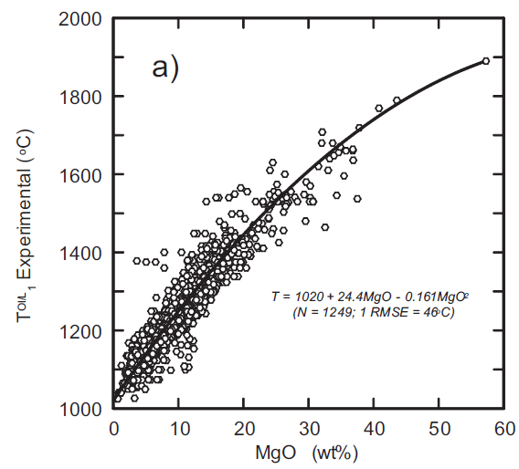
Potential Temperature
T^{Ol}_{L} = 1020 + 24.4MgO - 0.161MgO²
Experimental liquidus temperature (in °C) of olivine at 1 atm.
10
20
30
38
Wt% MgO contents of melts
T^{Ol}_{L} = 1020 + 24.4MgO - 0.161MgO²
In this way it would be possible to calculate the T at different P starting from MgO content of olivine-phyric melts
T_{p}^{Ol}_{L} = T^{Ol}_{L} + 54P - 2P²
Solidus of peridotite KR4003
Olivine liquidus temperature (in °C) as function of P (in GPa).
Herzberg and Asimow, 2015 (G3, 16, 563-578)
Notes:
78

Slide 79
Potential Temperature
T^{Ol}_{L} = 1020 + 24.4MgO - 0.161MgO²
Experimental liquidus temperature (in °C) of olivine at 1 atm.
10
20
30
38
Wt% MgO contents of melts
T^{Ol}_{L} = 1020 + 24.4MgO - 0.161MgO²
Conclusion:
High MgO = High T
Valid for volatile-free mantle solidi only.
T_{p}^{Ol}_{L} = T^{Ol}_{L} + 54P - 2P²
Solidus of peridotite KR4003
Olivine liquidus temperature (in °C) as function of P (in GPa).
Herzberg and Asimow, 2015 (G3, 16, 563-578)
Notes:
79

Slide 80
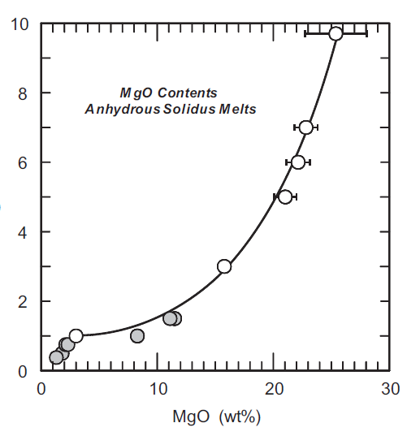
Potential Temperature
P_{solidus} =
MgO^{-0.52} exp(0.13 + 0.15MgO)
10
20
30
38
Wt% MgO contents of melts
14 wt%
This is the equation to describe the solidus of anhydrous peridotite melts as function of pressure
24 wt%
P_{solidus} (GPa)
24 wt%
14 wt%
Solidus of peridotite KR4003
Herzberg and Asimow, 2015 (G3, 16, 563-578)
Notes:
80

Slide 81
Potential Temperature
P_{solidus} =
MgO^{-0.52} exp(0.13 + 0.15MgO)
10
20
30
38
Wt% MgO contents of melts
Conclusion:
High MgO = High P
P_{solidus} (GPa)
again:
valid for volatile-free mantle solidi only.
Solidus of peridotite KR4003
Herzberg and Asimow, 2015 (G3, 16, 563-578)
Notes:
81

Slide 82
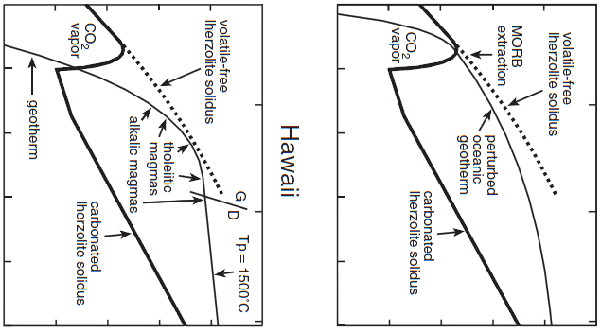
Potential Temperature
Temperature (°C)
Temperature (°C)
800
1000
1200
1400
1600
1800
800
1000
1200
1400
1600
1800
0
Lid
Typical MORB extraction depth
Dry Peridotite Solidus
2
Dry Peridotite Solidus
Lid
4
Pressure (GPa)
Hawaii
MORB
6
8
Why is the MORB geotherm considered “perturbed”?
10
Presnall and Gudfinnsson, 2011 (J. Petrol., 52, 1533-1546)

Slide 83
Potential Temperature
Temperature (°C)
Temperature (°C)
800
1000
1200
1400
1600
1800
800
1000
1200
1400
1600
1800
0
Lid
Typical MORB extraction depth
Dry Peridotite Solidus
2
Dry Peridotite Solidus
Lid
4
Pressure (GPa)
Hawaii
MORB
6
8
Is the Hawaiian mantle warmer than the MORB mantle?
What is the T @ 2 GPa under Hawaii and under MOR?
10
Presnall and Gudfinnsson, 2011 (J. Petrol., 52, 1533-1546)

Slide 84
Potential Temperature
Temperature (°C)
Temperature (°C)
1350-1500 °C
~1280 °C
800
1000
1200
1400
1600
1800
800
1000
1200
1400
1600
1800
Tp range of Hawaiian Lavas
Typical Tp of MORB
0
Typical MORB extraction depth
Dry Peridotite Solidus
2
Dry Peridotite Solidus
Estimated depth of extraction of Hawaiian lavas
4
Pressure (GPa)
Hawaii
MORB
6
8
Note that, at 10 GPa, the same Tp is assumed for Hawaii and MORB.
10
Presnall and Gudfinnsson, 2011 (J. Petrol., 52, 1533-1546)
Tp 1500 °C! (McK&B = 1280 °C)

Slide 85
Potential Temperature
Temperature (°C)
Temperature (°C)
1350-1500 °C
~1280 °C
800
1000
1200
1400
1600
1800
800
1000
1200
1400
1600
1800
Tp range of Hawaiian Lavas
Typical Tp of MORB
0
Typical MORB extraction depth
Dry Peridotite Solidus
2
Dry Peridotite Solidus
Estimated depth of extraction of Hawaiian lavas
4
Pressure (GPa)
Hawaii
MORB
6
According to this view, the Hawaiian magmas are formed at higher Tp compared with typical MORB.
This Tp difference (~70-320 °C) is simply related to different depths of melt extraction, not to heat excess.
8
10
Presnall and Gudfinnsson, 2011 (J. Petrol., 52, 1533-1546)

Slide 86
Potential Temperature
Temperature (°C)
Temperature (°C)
Hawaiian basalts indicate melt extraction over a very wide pressure range from about 2.5-3 GPa (early alkalic lavas) to about 4-5.5 GPa (tholeiitic lavas) and then back to very late alkalic magmas at 5.5-6 GPa for the late alkalic lavas.
This matches the seismic data indicating maximum melting in the LVZ at ~150 km and smaller amounts of melting at both lesser and greater pressures.
The late alkalic lavas contain diamond-bearing xenoliths, which guarantees their high-pressure origin.
1350-1500 °C
~1280 °C
800
1000
1200
1400
1600
1800
800
1000
1200
1400
1600
1800
Tp range of Hawaiian Lavas
TypicalTp of MORBs
0
Typical MORB extraction depth
Dry Peridotite Solidus
2
Dry Peridotite Solidus
Estimated depth of extraction of Hawaiian lavas
4
Pressure (GPa)
Hawaii
MORBs
6
8
10
Presnall and Gudfinnsson, 2011 (J. Petrol., 52, 1533-1546)
Notes:
86

Slide 87
Potential Temperature
Two are the main models concerning the Mantle Potential Temperature:
1) The “normal” mantle potential temperature is the temperature recorded by MORB.
If a basaltic melt records temperatures higher than those recorded in MORB, it means that it source is hotter than the MORB source. The difference in temperature is considered an “anomaly” in the mantle thermal structure.
The temperature excess is considered a consequence of the upwelling of a hot-spot or mantle plume, likely coming from very deep (D’’).
Notes:
87

Slide 88
Potential Temperature
Remember this?
Temperature (°C)
1000
2000
3000
4000
0
According to this classical view the higher temperature recorded by non-MORB magmas is related to heat excess in the superadiabatic D’’ region.
1000
Depth (km)
2000
3000
Notes:
88

Slide 89
Potential Temperature
Two are the main models concerning the Mantle Potential Temperature:
2) The concept of “normal” mantle potential temperature does not exist.
The temperature at the base of a plate (e.g., at ~100 km) is not uniform, but varies as consequence of several geological processes (partial melt extraction, delamination, subduction, solid-state convection, and so on).
In a cooling, internally-heated, mantle the potential temperature changes continuously with depth and every depth has a unique Tp.
Notes:
89

Slide 90
Potential Temperature
Two are the main models concerning the Mantle Potential Temperature:
The difference between the two above models stays on the assumptions:
Assuming an adiabatic sub-lithospheric mantle and a “normal” mantle potential temperature of 1280 °C, magmas formed at higher temperatures (e.g., in mid-plate areas such as Hawaii) come from hotter sources.
Alternatively
The MORB source is colder (and shallower) than elsewhere (because extensive melting cools the upper mantle). In this case the anomaly is not the mid-plate mantle but the MORB sources.
Notes:
90

Slide 91
Potential Temperature
Two are the main models concerning the Mantle Potential Temperature:
Temperature (°C)
1000
2000
3000
4000
Remember that there is another alternative…
0
“Hot-spot” source
MORB source
MORB can be colder because they derive from deeper sources from a non-adiabatic Earth’s interior.
1000
Depth (km)
2000
Subadiabatic Geotherm
Classical Geotherm
3000
Notes:
91

Slide 92
Potential Temperature
Two are the main models concerning the Mantle Potential Temperature:
The mantle under ridges cools more rapidly than under thick plates because the conduction layer is largely absent, heat is delivered rapidly to the surface by convection and removed into the ocean and atmosphere and by lateral advection (plate spreading), and the refrigeration effect due to massive melting.
Large thick plates may insulate the mantle preventing the rapid cooling that occurs at ridges.
Notes:
92

Slide 93
Potential Temperature
Two are the main models concerning the Mantle Potential Temperature:
The temperature differential between MORB and OIB can be related to:
Massive amount of melting at MOR (reducing the residual mantle temperature by about 100 °C by the latent heat refrigeration effect);
Removal of radioactive elements (lowering the amount of internal heating);
Insulating effect of thick large plates in OIB (preventing rapid cooling).
Notes:
93

Slide 94
Potential Temperature
Many geochemists/petrologists follow the Cambridge model (i.e., MORB Tp = Average Upper Mantle Temperature)
“A Tp of ~1550 °C is required for the production of Hawaiian magmas […] with 18–19% MgO, and >1600 °C for Gorgona picrites with 23% MgO. The excess temperature is the difference between the Tp of an oceanic island mantle source and ambient mantle that produced MORB. It is typically about 200–300 °C” Herzberg et al., 2007 (G3, doi:10.1029GC001390)
“…Geochemistry provides convincing evidence that mantle plumes are 100–300 °C hotter than normal upper mantle” White, 2010 (Ann. Rev. Earth Planet. Sci. 38, 133-160)
Notes:
94

Slide 95
Potential Temperature
Likely, the things are different…
“Long wavelength temperature variations of the asthenosphere (LAM) depart from the mean by ±200 °C, not the ±20 °C adopted by plume theoricians”.
“The ‘normal’ variation, caused by plate tectonic processes (subduction cooling, continental insulation, small scale convection) encompasses the temperature excesses that have been attributed to hot jets and thermal plumes.” (Anderson, 2000, Geophys. Res. Lett., 27, 3623-3626).
Notes:
95

Slide 96
Potential Temperature
Where/When does a magma form?
Temperature (°C)
900
1100
1300
1500
1700
0
Where/when its temperature encounters the Solidus.
Anhydrous Solidus
2
or Thermal Boundary Layer
Conductive Layer
100
Can a mantle with such a temperature (Geotherm) experience partial melting?
4
Pressure (GPa)
(one of the possible)
Geotherm
Depth (km)
6
No, obvioulsy
200
8
Notes:
96

Slide 97
Potential Temperature
Where/When does a magma form?
Temperature (°C)
900
1100
1300
1500
1700
0
1110
1220
1350
1480
1550
E
An upwelling mantle volume may start melting at A, B, C, D, E, …, when it crosses the local solidus.
Anhydrous Solidus
D
2
C
Partial melting begins
or Thermal Boundary Layer
Conductive Layer
A, B, C, D, E, …
100
B
4
A
Pressure (GPa)
(one of the possible)
Geotherm
Depth (km)
6
What is the Mantle Potential Temperature at these points?
200
8
Notes:
97

Slide 98
Potential Temperature
To calculate Tp you should raise the parcel along a solid mantle adiabat from the melting depth to the surface.
It is not a matter if the mantle was on the conductive or convective segment of the geotherm…
Temperature (°C)
900
1100
1300
1500
1700
0
1110
1220
1350
1480
1550
E
Anhydrous Solidus
D
2
C
Partial melting begins
or Thermal Boundary Layer
Conductive Layer
B
100
4
A
Pressure (GPa)
(one of the possible)
Geotherm
Depth (km)
6
What is the Mantle Potential Temperature at these points?
200
8
Notes:
98

Slide 99
Potential Temperature
The distinction between “cold” and “hot” mantle sources can be approached investigating the composition of basaltic (as well as picritic and kimberlitic) magmas.
During transit to and within the crust the magmas can experience:
Variable conditions of partial melting;
Fractional crystallization;
Crustal contamination;
Magma mixing.
These effects cannot be easily isolated.
This is the primary magma problem in mantle petrology
Notes:
99

Slide 100
Potential Temperature
The potential temperature of a melt is calculated on the basis of its MgO content, assuming that high MgO melts are formed at high temperatures.
Usually Tp is calculated (Herzberg and O’Hara, 2003):
Tp (ºC) = 1463 + 12.74*MgO - 2924/MgO.
An updated equation to calculate Tp is (Herzberg and Asimow, 2015):
Tp (ºC) = 1025 + 28.6*MgO – 0.084*MgO².
Tp can also be calculated directly from T^{Ol}_{L}:
Tp (ºC) = 1.05T^{Ol}_{L} - 0.00019(T^{Ol}_{L})² + 1.49*10⁻⁷(T^{Ol}_{L})³
Notes:
100

Slide 101
Potential Temperature
The potential temperature of a melt is calculated on the basis of its MgO content, assuming that high MgO melts are formed at high temperatures.
[PROBLEM]:
The MgO measured in an igneous rock never represents the original MgO of the melt produced immediately after partial melting.
WHY?
Notes:
101

Slide 102



Potential Temperature
Close to the MOHO the primitive basaltic melt starts cooling and fractionate dense minerals, essentially MgO-rich olivine.
The evolved liquid is MgO- (and FeO-) poorer (and lighter) compared with original melt, therefore it can re-start its uprise to the Earth’s surface.
Upper Crust
(Relatively light)
At lower crustal levels, the basaltic melt stops and stagnate because there is no more density contrast.
Lower Crust
(Mildly dense)
Basaltic melt
The basaltic melt buoyantly upwells because of its lower density compared with mantle phases (olivine)
Mantle
(Very dense)
Notes:
102

Slide 103
Potential Temperature
To calculate the original MgO content of a melt, a certain amount of olivine is added to the composition of the rock until a composition in equilibrium with the Fo-richest olivine is obtained.
This approach may lead to wrong results.
Notes:
103

Slide 104
Potential Temperature
“An inverse model attempts to reconstruct the processes of fractional crystallization in order to identify an array of potential melt or primary magma compositions that may have formed in the mantle.”
“At some stage, olivine must be added incrementally to move up in temperature toward more primitive compositions, and it is necessary to know at what point the computed melt reflects the primary magma composition in the mantle; that is, how do we know when to stop adding olivine?”
Herzberg and Asimow, 2015 (G3, 16, 563–578, doi:10.1002/2014GC005631.
Notes:
104

Slide 105
Potential Temperature
Follow this sequence:
Analyze with EMP olivine in basaltic rocks;
Select the olivine with the highest Fo;
Calculate the composition (the MgO content) of the melt in equilibrium with this olivine assuming the relation: K_{D} = (FeO_{ol})/(FeO_{melt}) * (MgO_{melt})/(MgO_{ol})
On the basis of this MgO content (higher than what really measured in the rock), calculate the Tp using the relation: Tp (ºC) = 1463+12.74*MgO-2924/MgO
Often what is calculated is the hypothetical composition of the original magma, before olivine crystallization. This is done adding olivine to the melt till approaching the hypothetical composition.
Notes:
105

Slide 106
Potential Temperature
The distribution coefficient:
K_{D} = (FeO_{ol})/(FeO_{melt})*(MgO_{melt})/(MgO_{ol})
relates the partitioning of Fe and Mg between olivine and liquid.
It has been calculated independent of temperature and equal to 0.30 in 1970 (Roeder and Emslie).
Following studies have slightly modified the value of this K_{D} to 0.31-0.35, no more.
Notes:
106

Slide 107

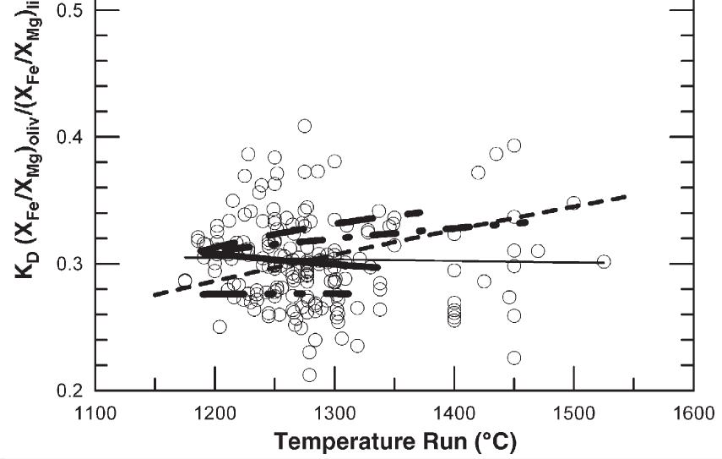
Potential Temperature
The distribution coefficient:
K_{D} = (FeO_{ol})/(FeO_{melt})*(MgO_{melt})/(MgO_{ol})
Falloon et al.,2007 (Chem. Geol., 241, 207-233)
KD (FeO_{melt}/FeO_{ol})*(MgO_{ol}/MgO_{melt})
Notes:
107

Slide 108
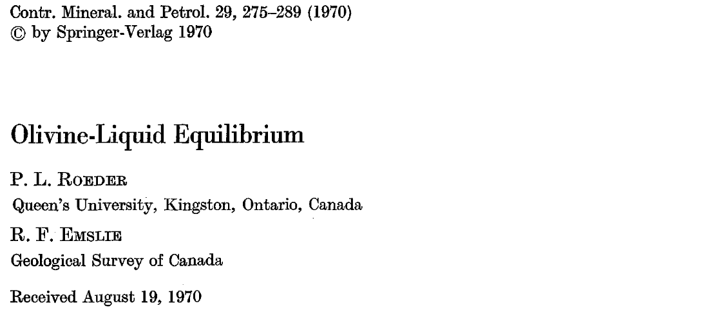
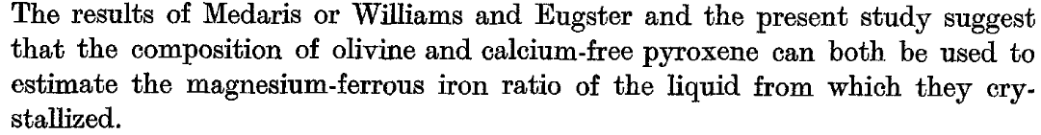
Potential Temperature
The distribution coefficient:
K_{D} = (FeO_{ol})/(FeO_{melt})*(MgO_{melt})/(MgO_{ol})
Notes:
108

Slide 109
Potential Temperature
The distribution coefficient:
K_{D} = (FeO_{ol})/(FeO_{melt})*(MgO_{melt})/(MgO_{ol})
What does a K_{D} = 0.30 mean?
We can write the K_{D} also in a different way:
K_{D} = (FeO/MgO)_{ol}/(FeO/MgO)_{melt}
(FeO/MgO)_{ol} =
Kd * (FeO/MgO)_{melt}
Let us assume an olivine that crystallizes from a basaltic melt. Does this olivine have higher Fe/Mg ratio than the liquid?
Notes:
109

Slide 110
Potential Temperature
The distribution coefficient:
K_{D} = (FeO_{ol})/(FeO_{melt})*(MgO_{melt})/(MgO_{ol})
What does a K_{D} = 0.30 mean?
We can write the K_{D} also in a different way:
K_{D} = (FeO/MgO)_{ol}/(FeO/MgO)_{melt}
(FeO/MgO)_{ol} =
Kd * (FeO/MgO)_{melt}
This means that, starting from a given Fe/Mg in the melt, what is the element preferentially allocated into olivine?
Mg
Notes:
110

Slide 111
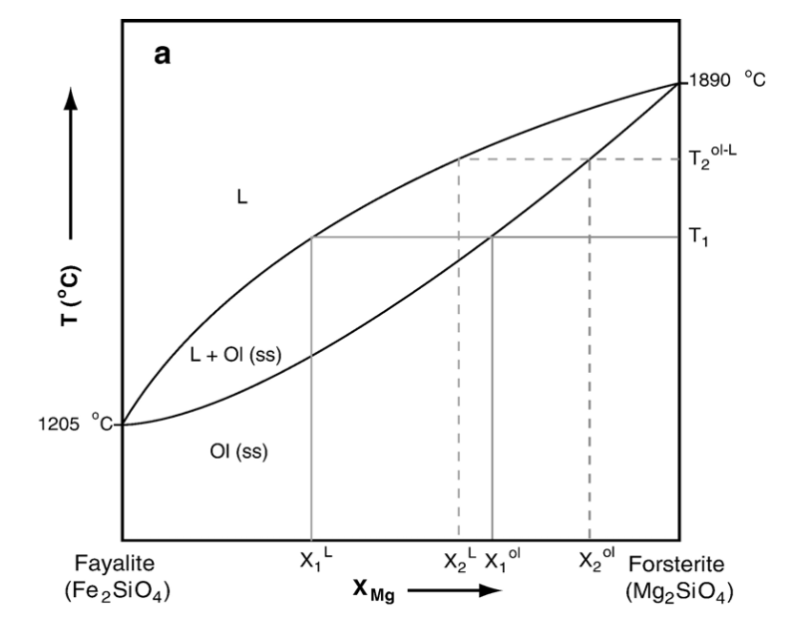
Potential Temperature
The distribution coefficient:
K_{D} = (FeO_{ol})/(FeO_{melt})*(MgO_{melt})/(MgO_{ol})
Do you remember this diagram?
The olivine in equilibrium with a melt is always richer in MgO.
This means that olivine has lower FeO/MgO than the melt.
FeO/MgO (melt) = 1
FeO/MgO (ol) = 0.3
melt
ol
Notes:
111

Slide 112
Potential Temperature
The distribution coefficient:
K_{D} = (FeO_{ol})/(FeO_{melt})*(MgO_{melt})/(MgO_{ol})
Let us make an example:
FeO_{ol} = 20.9 wt%; MgO_{ol} = 37.7 wt%.
FeO_{melt} = 9.2 wt%; MgO_{melt} = 7.5 wt%.
K_{D} = (FeO/MgO)_{ol}/(FeO/MgO)_{melt}
K_{D} = ?
K_{D} = (20.9/9.2)*(7.5/37.7)
?
= 0.45
K_{D} = (20.9/37.7)/(9.2/7.5)
= 0.45
K_{D} should be 0.30, why did we obtain 0.45?
Notes:
112

Slide 113
Potential Temperature
K_{D} 0.2
1:1 (K_{D} = 1)
K_{D} 0.1
K_{D} 0.3
K_{D} 0.8
K_{D} 0.6
Mg# = Mg/(Mg+Fe)
K_{D} 0.4
K_{D} = 1 means identical distribution of Fe/Mg (or Mg#) between melt and olivine. This is the base (wrong) assumption of CIPW norm.
Notes:
113

Slide 114
Potential Temperature
K_{D} 0.2
1:1 (K_{D} = 1)
K_{D} 0.1
K_{D} 0.3
K_{D} 0.8
K_{D} 0.6
K_{D} 0.4
Next slide
Notes:
114

Slide 115
Potential Temperature
1.0
0.8
K_{D} = 0.30
0.6
Mg# in olivine (Fo content)
Each color represents one sample.
0.4
In each sample olivines with different compositions (Fo) coexist.
0.2
In theory all the olivines should plot along the red line, but...
0
0.3
0.4
0.5
0.6
0.7
Mg# in melt
Notes:
115

Slide 116
Potential Temperature
1.0
0.8
K_{D} = 0.30
0.6
Mg# in olivine (Fo content)
0.4
Olivines above the red line have too much Mg to have been crystallized from that melt.
0.2
Nearly all the analyzed olivines are not in equilibrium with the melt.
0
0.3
0.4
0.5
0.6
0.7
Mg# in melt
Notes:
116

Slide 117
Potential Temperature
1.0
0.8
K_{D} = 0.30
0.6
Mg# in olivine (Fo content)
0.4
Olivines below the red line have too low Mg to have been crystallized from that melt.
0.2
Nearly all the analyzed olivines are not in equilibrium with the melt.
0
0.3
0.4
0.5
0.6
0.7
Mg# in melt
Notes:
117

Slide 118
Potential Temperature
1.0
0.8
K_{D} = 0.30
0.6
Mg# in olivine (Fo content)
How is it possible to have olivine Fo-richer (Mg-richer) than equilibrium olivine?
0.4
Xenocrysts or Antecrysts
0.2
How is it possible to have olivine Fo-poorer (Fe-richer) than equilibrium olivine?
Recycling of phases crystallized in more evolved melts
0
0.3
0.4
0.5
0.6
0.7
Mg# in melt
Notes:
118

Slide 119
Potential Temperature
1.0
0.8
K_{D} = 0.30
0.6
Mg# in olivine (Fo content)
0.4
Is it correct to say that the TRUE Mg# of the melt is that calculated considering the olivine with the highest Fo?
0.2
0
0.3
0.4
0.5
0.6
0.7
Mg# in melt
Notes:
119

Slide 120
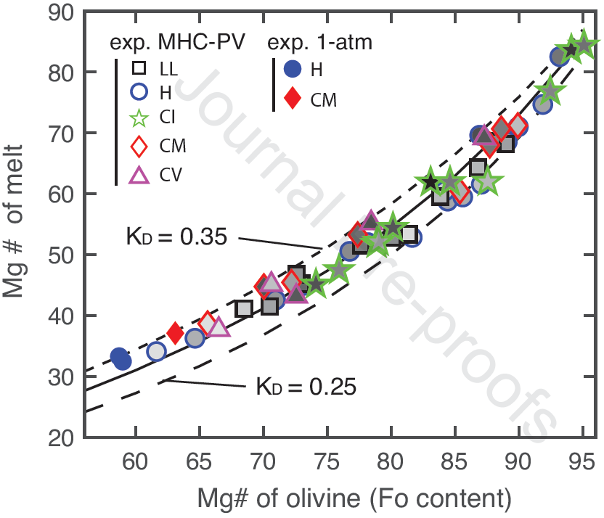
Potential Temperature
Partial melting experiments on carbonaceous and ordinary chondrites
Collinet and Grove, 2020 (Geochim. Cosmochim. Acta, 277, 334-357)
Notes:
120

Slide 121
Potential Temperature
Think about this:
Mg tends to remain in the solid residuum during mantle partial melting while Fe preferentially goes into the melt;
High-degree melts will have higher Mg/Fe ratios than low-degree melts;
Olivine crystallizing from a high Mg/Fe melt will have higher Fo content than those forming from a low Mg/Fe melt;
High Fo olivines in basaltic melts are considered a proof for high degrees of melting.
Is the so-calculated high degree of melting indicative of high absolute temperature of the mantle source?
Notes:
121

Slide 122
Potential Temperature
High magma production (high degree of melting) can be related to High Homologous Temperature rather than high Absolute Temperature.
The Homologous Temperature is the ratio of the temperature of a substance to the melting temperature (solidus for natural systems) of the same substance.
In a lherzolitic mantle at a given depth, the H.T. may be: 1000°C/1300°C = 0.76.
At the same depth, in an eclogite-bearing mantle the H.T. may be: 1000°C/1000°C = 1.00.
An eclogite-bearing mantle has higher H.T.
Notes:
122

Slide 123
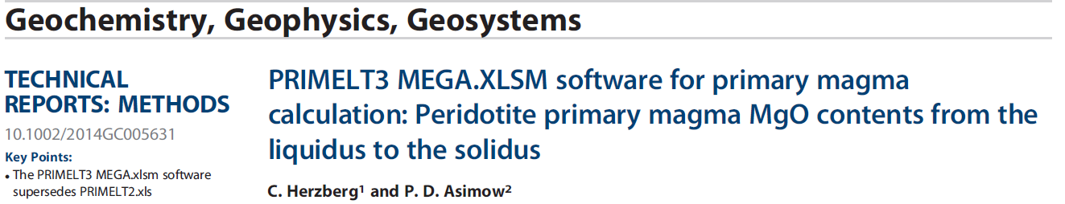
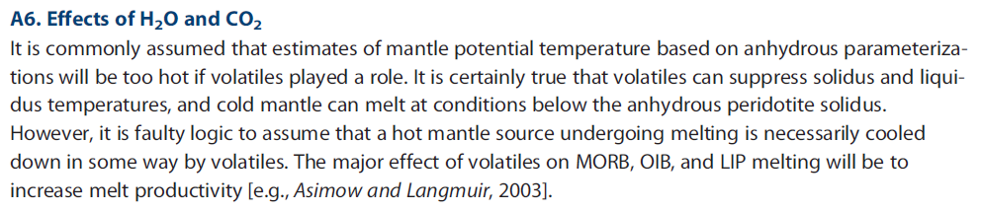
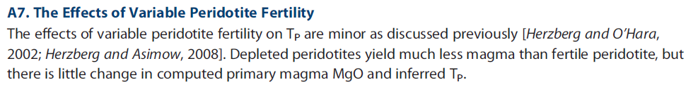
Potential Temperature
? Not clear to me.
But a fertile mantle has higher Fe and consequentially lower Mg/Fe (and Mg#, of course).
Notes:
123

Slide 124
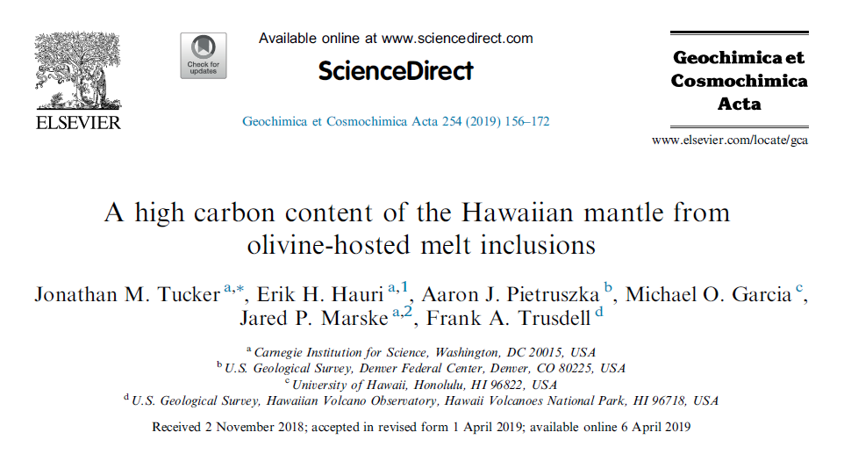
Potential Temperature
[…]
C-bearing mantle sources can provide wrong results.
→
Notes:
124

Slide 125
Let’s make another Exercise
Let’s calculate the composition of a melt in equilibrium with a given olivine with variable Forsterite content.
Let’s calculate also the composition of an hypothetical olivine in equilibrium with a melt with a given Mg#.
Exercise #3
Notes:
125

Slide 126
Potential Temperature
There are several problems in transforming the Fo content in olivine into temperature estimates:
1) There are no olivine-controlled trends for MORB glasses.
Except for the Puna Ridge trend, all of the olivine-controlled trends are artificially produced by adding olivine back into observed glass compositions.
Notes:
126

Slide 127
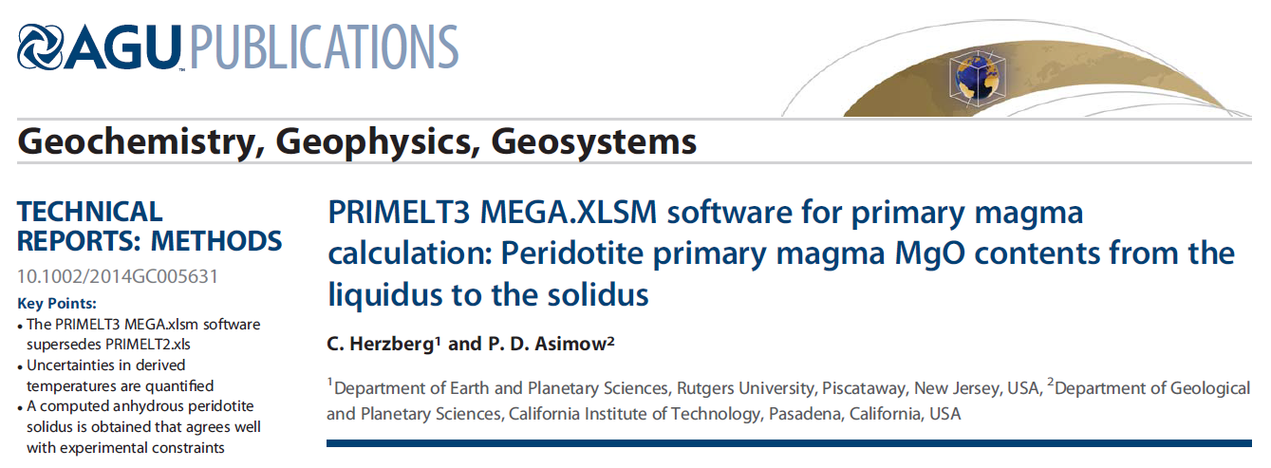
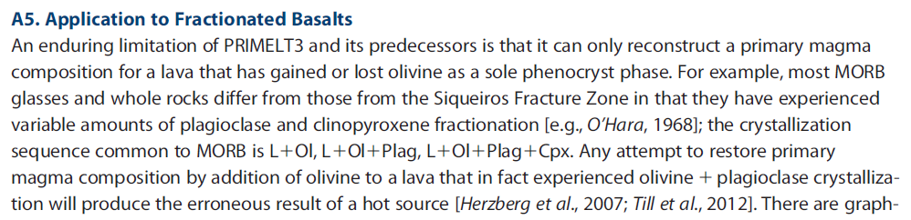
Potential Temperature
[…]
Notes:
127

Slide 128
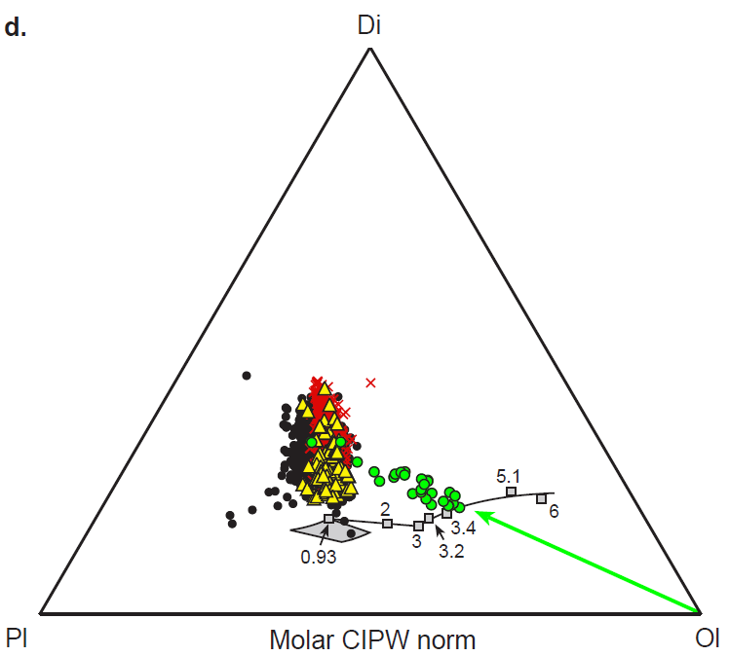
Potential Temperature
Di
MORB glasses
MORB glasses (Mg#>68)
X
Iceland glasses
Puna Ridge glasses from Kilauea
Experimental glasses
Pl
Ol
Presnall and Gudfinnsson (2011) J. Petrol., 52, 1533-1546
Notes:
128

Slide 129
Potential Temperature
There are several problems in transforming the Fo content in olivine into temperature estimates:
2) The Fo-richest olivine can be fragments of the mantle, not liquidus olivine.
A detailed chemical and petrographic investigation is fundamental to distinguish the two types of olivines.
Notes:
129

Slide 130
Potential Temperature
There are several problems in transforming the Fo content in olivine into temperature estimates:
3) The high Fo content of olivine can be related to Fe-poor mantle.
A depleted mantle is Fe-poor and Mg-rich. Partial melts of this source will be Fe-poor and Mg-rich and have high Mg#.
Olivine crystallizing from this kind of melts will be Fe-poor and, therefore, Fo-rich.
Notes:
130

Slide 131
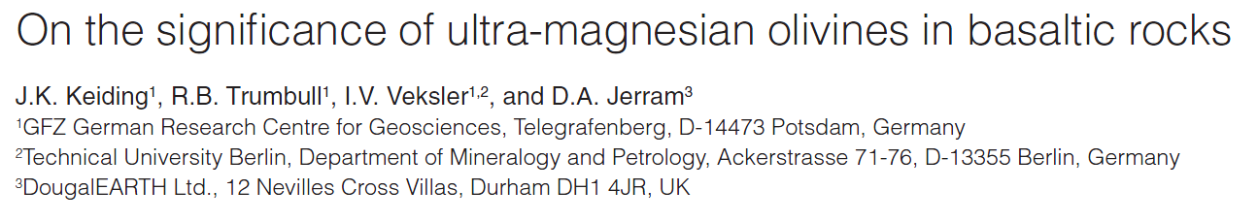
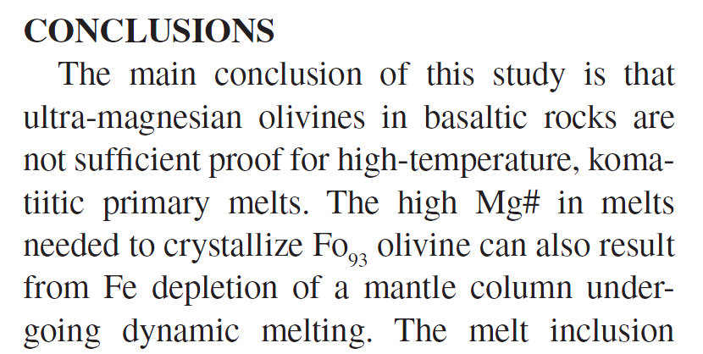
Potential Temperature
Notes:
131

Slide 132
Potential Temperature
There are several problems in transforming the Fo content in olivine into temperature estimates:
4) Melts generated after high degrees of melting are characterized by high Mg# and, consequentially, will crystallize Fo-rich olivine.
It is not necessary to have high T to generate high amount of melting. Melting can be generated with volatile flushing (H and C, above all) and with the presence of low-solidus olivine-poor lithologies (eclogites).
Notes:
132

Slide 133
Potential Temperature
There are several problems in transforming the Fo content in olivine into temperature estimates:
4) Melts generated after high degrees of melting are characterized by high Mg# and, consequentially, will crystallize Fo-rich olivine.
If an upwelling mantle melts at high depths, it will experience more and more melting moving to the surface.
Notes:
133

Slide 134
Potential Temperature
There are several problems in transforming the Fo content in olivine into temperature estimates:
5) Fo-rich olivines can crystallize in a highly oxidized melt.
If Fe³⁺ become particularly abundant in specific conditions magnetite crystallization is favoured. This depletes the residual magma in Fe²⁺. Late olivine can crystallize with MgO-rich (up to Fo₉₉) compositions.
Notes:
134

Slide 135
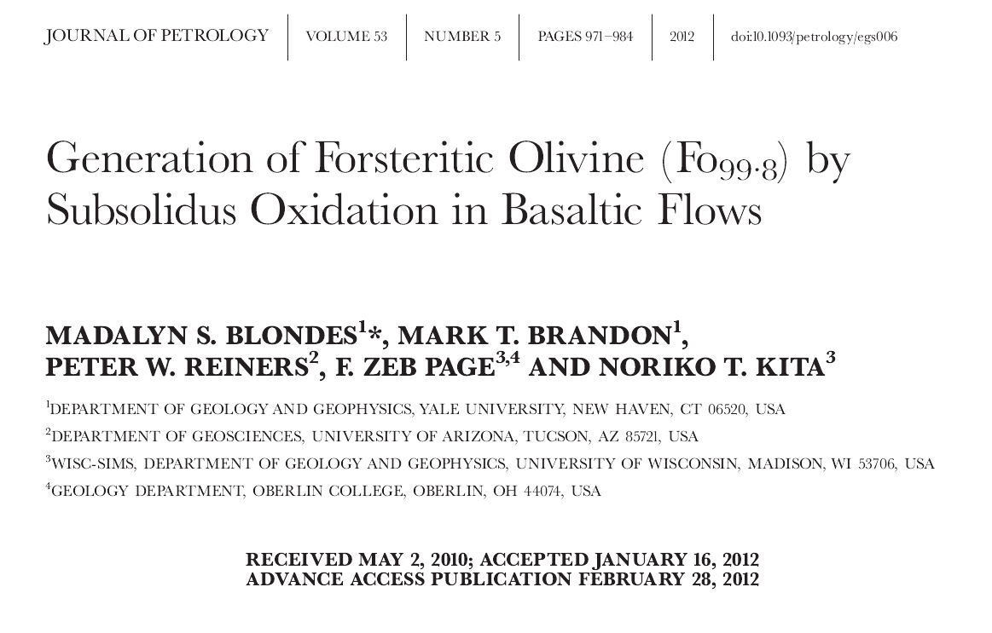
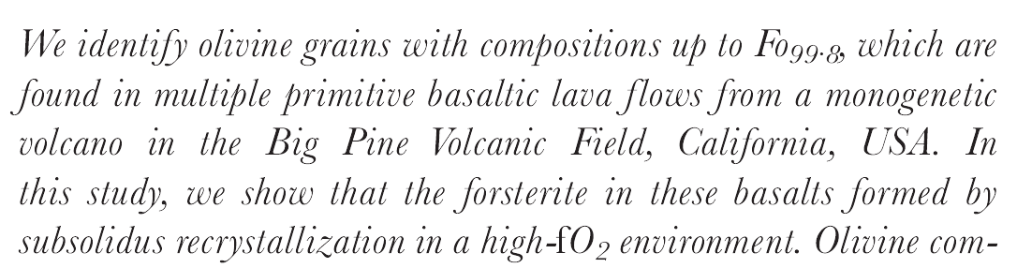
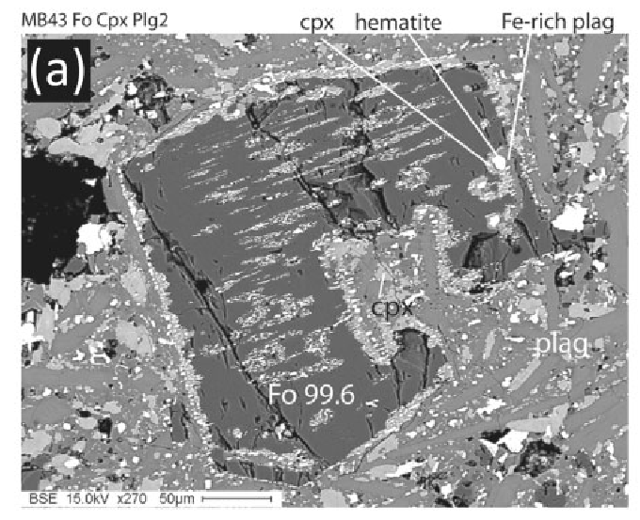
Potential Temperature
Notes:
135

Slide 136
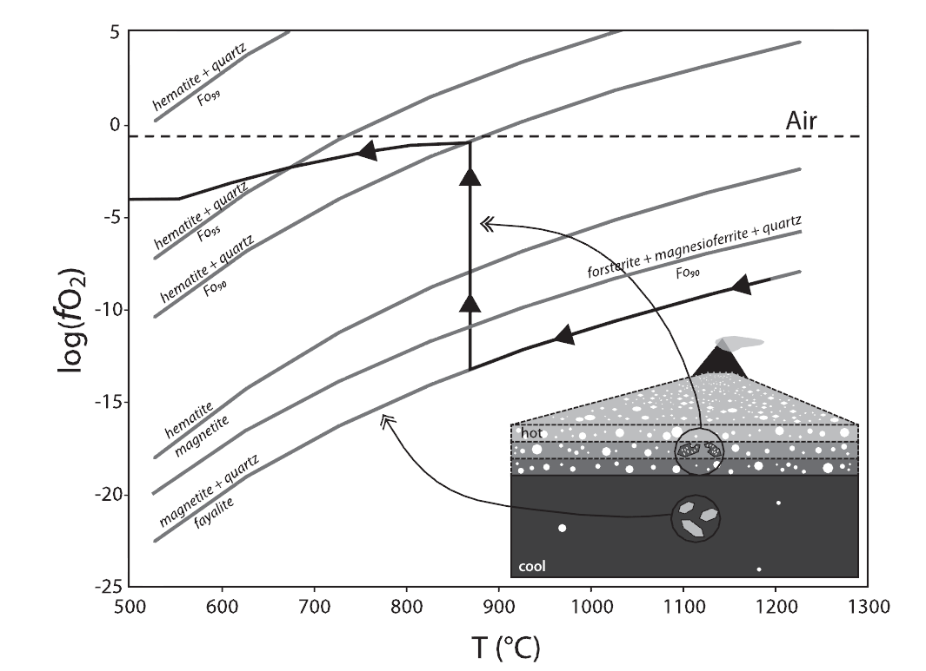
Potential Temperature
No Magnetite found
Magnetite found
Notes:
136
For the highly vesicular, thin lava spatter units, the temperature will remain high with repeated eruptions while abundant air is trapped in the vesicles. The oxidized olivine
is no longer buffered by magnetite and reaches the FHQFo90 buffer near the fO2 of air. The olivine will then slowly cool along a series of FHQFo90^FHQFo99 buffers as the Mg-number of the olivine increases. At 600 °C, the reaction will cease.

Slide 137
Potential Temperature
There are several problems in transforming the Fo content in olivine into temperature estimates:
6) Fo-rich olivines can be generated after subsolidus substitution with spinel.
Cr-rich spinel prefers Fe (forming chromite Fe²⁺Cr₂O₄) rather than Mg (Mg-chromite MgCr₂O₄). If olivine is present, it will exchange Fe with chromite, accepting Mg from the spinel. The result will be Fo-rich olivine.
Notes:
137

Slide 138
Potential Temperature
There are several problems in transforming the Fo content in olivine into temperature estimates:
7) If present, phlogopite in the mantle melts incongruently giving K-OH-rich melt + Fo-rich (up to Fo₉₅) peritectic olivine.
These SiO₂-undersaturated K-OH-rich melts react with mantle enstatite dissolving it. In this way the melts become MgO-rich (18-30 wt% MgO) and with high Mg#. Olivine crystallizing from this melt will be Fo-rich.
Prelevic (2015, written communication)
Notes:
138

Slide 139
Potential Temperature
There are several problems in transforming the Fo content in olivine into temperature estimates:
7) If present, phlogopite in the mantle melts incongruently giving K-OH-rich melt + Fo-rich (up to Fo₉₅) peritectic olivine.
Possible subsequent melting of this phlogopite-free mantle, rich in Fo-rich peritectic olivine, can produce Mg# rich melts that can crystallize Fo-rich olivines.
Prelevic (2015, written communication)
Notes:
139

Slide 140
Potential Temperature
There are several problems in transforming the Fo content in olivine into temperature estimates:
8) Fo-rich (up to Fo₉₃) olivine forms as liquidus phase of a MARID melt.
MARID rocks are lithologies composed essentially of Mica + Amphibole, Rutile, Ilmenite and Diopside.
MARID partial melts are Mg-rich and crystallize Fo-rich olivine, but at “normal” to “relatively low” temperatures.
Prelevic (2015, written communication)
Notes:
140

Slide 141
Potential Temperature
There are several problems in transforming the Fo content in olivine into temperature estimates:
9) Fo-rich (up to Fo₉₄) olivine forms in a melt derived from dolomite-bearing mantle.
Dolomite is the stable carbonate in the ~2-3 GPa depth range. A mixed carbonatitic-silicatic melt with cooling can split the MgO content of dolomite forming Fo-rich olivine, leaving CaO-rich carbonatite, which can eventually collapse at P <2GPa.
Prelevic (2015, written communication)
Notes:
141

Slide 142
Potential Temperature
There are several problems in transforming the Fo content in olivine into temperature estimates:
10) Fo-rich (up to Fo₉₇) olivine can crystallize if ultrabasic melt digests limestone.
Nearly pure Fo can be obtained adding calcite to melilititic melt at shallow P (2 kb) and variable T (1100-1300 °C).
Notes:
142

Slide 143
Potential Temperature
There are several problems in transforming the Fo content in olivine into temperature estimates:
10) Fo-rich (up to Fo₉₇) olivine can crystallize if ultrabasic melt digests limestone.
- Calcite digestion adds Ca to the melt.
- Ca enters the M2 olivine site, the same site of Fe.
- Mg can enter both M1 and M2 olivine sites.
- Addition of Ca limits space for Fe, leading to higher Mg/Fe (coupled with lower Mg/Ca) in olivine. Very high Fo content can be produced.
Notes:
143

Slide 144
Potential Temperature
1) Picritic magmas (Olivine- and MgO-rich tholeiites) from Hawaii show high-Fo olivines (Fo₈₈₋₉₁).
2) The magma in equilibrium with the highest Fo olivines must have ~15-16 wt.% MgO.
3) The calculated MgO composition is typically higher than the measured whole-rock MgO composition.
4) It is possible to calculate the temperature of formation of a magma using geothermometers (olivine-melt Fe/Mg exchange).
5) The geothermometric results for the Hawaiian picrites indicate liquidus temperature ~1315 °C.
Green et al., 2001 (Eur. J. Mineral., 13, 437-451)
Notes:
144

Slide 145
Potential Temperature
1) The most MgO-rich MORB have 13-14 wt.% MgO.
2) The most magnesian olivines of these picritic MORB reach Fo₉₁₋₉₂.
3) As observed for the Hawaiian picrites, the calculated MgO composition is typically higher than the measured whole-rock MgO composition.
4) It is possible to calculate the temperature of formation of a magma using geothermometers (olivine-melt Fe/Mg exchange).
5) The geothermometric results for the MORB picrites indicate liquidus temperature ~1325 °C.
Green et al., 2001 (Eur. J. Mineral., 13, 437-451)
Notes:
145

Slide 146
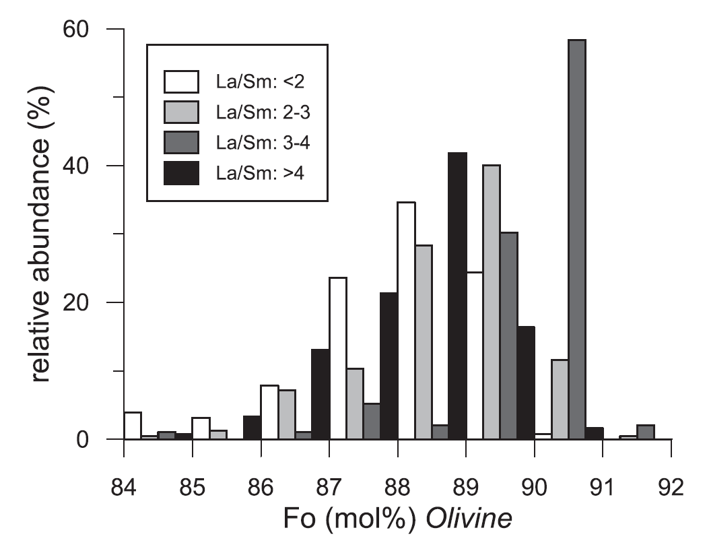
Potential Temperature
Range of compositions of olivine found in McQuarie Island (S. Pacific) – MORB lavas.
Husen et al., 2016 (Geochim. Cosmochim. Acta 185, 112-128)
Notes:
146

Slide 147
Potential Temperature
The most forsteritic olivine in a rock, or surmised to be representative of a liquid in equilibrium with the mantle, is probably not related to the host liquid composition along a single closed system liquid line of descent.
That assumption is the entire basis for the procedure of adding incrementally more forsteritic olivine into liquid compositions until an “equilibrium” liquid is reached, but it is wrong.
Natland [in: Falloon et al., 2007 (Geol. Soc. Am. Spec. Paper, 430, 252-253)]
[…] Hawaii, Iceland, and Samoa have Tp values that do not overlap with MORB within 2σ.
Putirka and Rhodes [in: Falloon et al., 2007 (Geol. Soc. Am. Spec. Paper, 430, 253-254)]
Notes:
147

Slide 148
Two completely opposite views:
The average temperatures of eruption and the depth of extraction of primary magmas at the Hawaiian ‘Hot-Spot’ (cone-building phase) are measured to be roughly the same (1290-1370 °C; 1-2.5 GPa) as those of primary magmas in mid-ocean-ridge settings (1240-1350 °C; 1-2 GPa).
Green et al., 2001 (Eur. J. Mineral., 13, 437-451)
Experimental phase-equilibrium data […] show pressure-temperature conditions of tholeiitic melt extraction at Hawaii (4-5 GPa, 1450-1500 °C) and the global oceanic ridge system (1.2-1.5 GPa, 1250-1280 °C) […].
Presnall and Gudfinnsson, 2011 (J. Petrol., 52, 1533-1546)
Notes:
148

Slide 149


Potential Temperature
More information about the thermal state of the mantle and the significance of the Potential Temperature can be found in:
…and in several scientific papers published in international journals (e.g., J. Petrol., Contrib. Mineral. Petrol., Geochem. Geophys. Geosyst., J. Geophys. Res., and so on).
2010
2007
Notes:
149

Slide 150
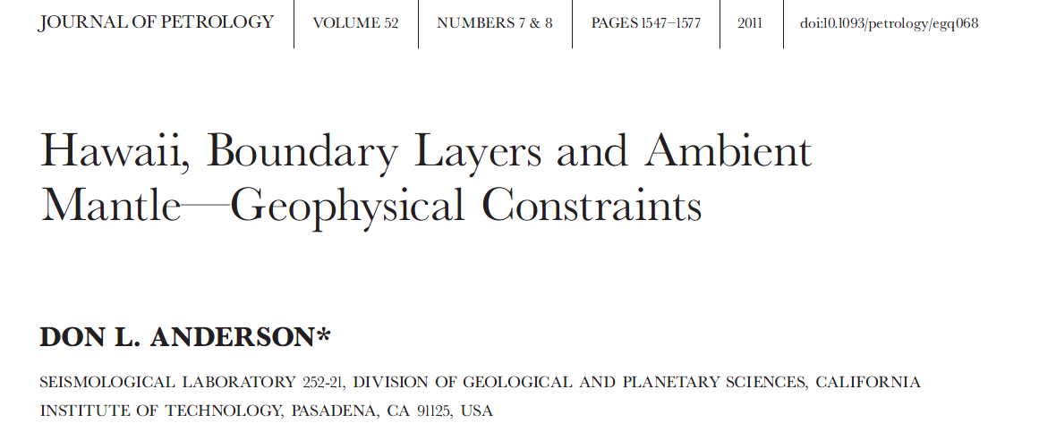
Potential Temperature
More information about the thermal state of the mantle and the significance of the Potential Temperature can be found in:
Among the recent papers I prefer the following:
Notes:
150

Slide 151
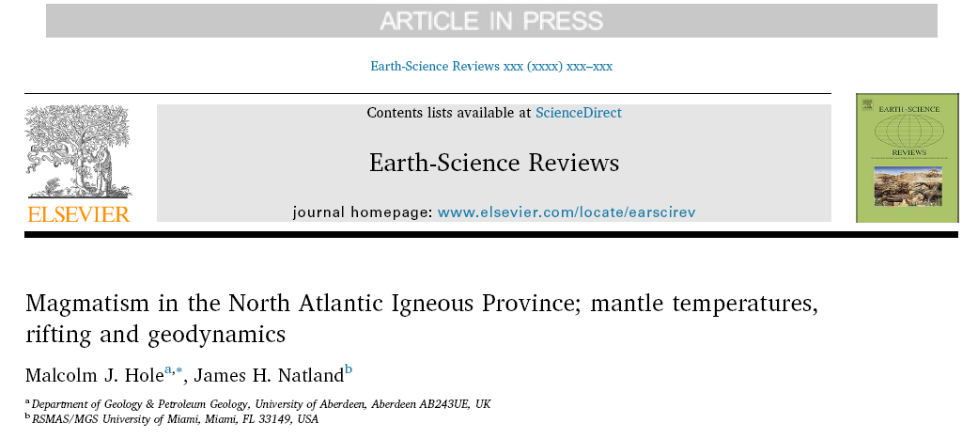
Potential Temperature
More information about the thermal state of the mantle and the significance of the Potential Temperature can be found in:
Among the recent papers I prefer the following:
2020 (in press)
Notes:
151

Slide 152
Do you think the mantle is:
Adiabatic?
Isothermal?
Homogeneous?
Devoid of U, Th, K ?
Constant T at 100 km depth?
Does not cool with time?
Are these the assumptions underlying the 1988 geotherm?
Notes:
152

Slide 153
To resume:
Give me a definition for:
Geotherm
Mantle Adiabat
Potential Temperature

Slide 154
Home exercises to test your comprehension of the problems:
a) Does it exist a single geotherm?
b) How can a local geotherm be perturbed?
c) Is the mantle adiabat similar for lithospheric and sub-lithospheric mantle?
d) Is the mantle adiabat higher or lower than melt adiabat? Why?
e) Can the melt adiabat vary?

Slide 155
Home exercises to test your comprehension of the problems:
f) Can potential temperature be directly measured?
g) How is potential temperature calculated?
h) Does the temperature in the uppermost mantle vary sub- or super-adiabatically?
i) Does higher potential temperature indicate higher absolute temperature?
k) Is Fo-rich olivine a proof for high T?

Slide 156
Home exercises to test your comprehension of the problems:
j) Is MORB Tp higher, equal or lower than Hawaiian magma Tp?
l) Is there a relation between T and P in the Earth’s mantle?
m) What could be the causes for subadiabatic geotherms?
n) Is convection possible in purely adiabatic conditions?
o) What is necessary for allowing convection?

Slide 157
Credits:
Anderson (2000) Geophys. Res. Lett., 27, 3623-3626
Anderson (2007) New Theory of the Earth, Cambridge University Press, 384 pp.
Anderson (2011) J. Petrol., 7-8, 1547-1577
Anderson and Natland (2014) Proc. Natl. Acad. Sci. 111, E4298-E4304
Blondes et al. (2012) J. Petrol., 53,971-984
Cadio et al. (2012) Earth Planet. Sci. Lett., 359-360, 40-54
Collinet and Grove (2020) Geochim. Cosmochim. Acta, 277, 334-357
Coltice et al. (2018) Tectonophysics, 746, 669-677
De Wit and Trampert (2015) Earth Planet. Sci. Lett., 429, 101-109
Falloon et al. (2007) Chem. Geol., 241, 207-233
Foulger (2010) Plates vs Plumes – A Geological Controversy. Wiley-Blackwell
Foulger (2012) J. Geodyn., 58, 1-28
Green and Falloon (2005) Geol Soc. Am. Spec. Paper, 388, 217-247
Green et al. (2001) Eur. J. Mineral. 13, 437-451
Guimaraes et al. (2020) Earth Planet. Sci. Lett., 536, 116147
Hassan et al. (2015) Geochem. Geophys. Geosyst., 16, 1465-1489
Herzberg et al (2007) Geochem. Geophys. Geosyst. 8, doi:10.1029GC001390-
Herzberg (2011) Geology, 39, 1179-1180
Herzberg and Asimow (2008) Geochem. Geophys. Geosyst., 8, doi:10.1029GC002057
Herzberg and Asimow (2015) Geochem. Geophys. Geosyst., 16, 563-578
Hoink and Lenardic (2008) Geophys. Res. Lett., 35, doi:10.1029/2008GL033854
Hole and Natland (2020) Earth-Sci. Rev., in press https://doi.org/10.1016/j.earscirev.2019.02.011
Husen et al. (2016) Geochim. Cosmochim. Acta 185, 112-128
Keiding et al. (2011) Geology, 39, 1095-1098
King (2015) Foulger, Lustrino and King (Eds.) AGU-GSA special vol. 87-103
McKenzie and Bickle (1988) J. Petrol., 29, 625-679
Moore (2008) J. Geophys. Res. doi:10.1029/2006JB004778
Nakagawa et al. (2015) Geochem. Geophys. Geosyst., 16, 1449-1464
Niu (2020) J. Asian Earth Sci., 194, 104367
Nomura et al. (2014) Nature, 343, 522-525
Presnall and Gudfinnsson (2011) J. Petrol., 52, 1533-1546
Putirka et al. (2007) Chem. Geol., 241, 177-206
Roeder and Emslie (1970) Contrib. Mineral. Petrol., 29, 275-289
Sinha and Butler (2007) J. Geophys. Res., 112, doi:10.1029/2006JB004850
Schuberth et al. (2009) Geochem. Geophys. Geosyst. doi:10.1029/2008GC002235
Sinha and Butler (2007) J. Geophys. Res., doi:10.1029/2006JB004850
Stixrude and Lithgow-Bertelloni (2012) (Annu. Rev. Earth Planet. Sci., 40, 569-595)
Tackley et al. (1993) Nature, 361, 699-704)
Terasaki et al. (2011) Earth Planet. Sci. Lett., 304, 559-564
Tucker et al. (2019) Geochim. Cosmochim. Acta, 254, 156-172
Ulvrova et al. (2019) Earth Planet. Sci. Lett., 528, 115836
White (2010) Annu. Rev. Earth Planet. Sci. 38, 133-160
Wilson (1963) Can. J. Phys., 41, 863-870
Zhong and Rudolph (2015) Geochem. Geophys. Geosyst., 16, 1599-1915
You can use this material for scientific and non-scientific purposes.
Please quote and acknowledge the source of data

